Slide 1

Unlock Your Trading Potential
ITI Graduation Project | Power Bi Developer | Qena Branch

Slide 2
Welcome!
North Wind Database: company that imports and exports specialty foods globally.

Slide 3





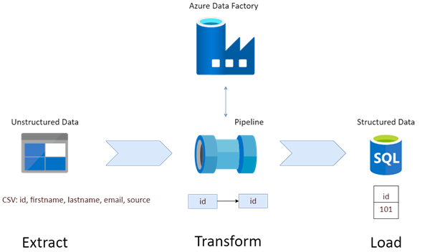







CONTENT
1
PHASE | Modeling
2
PHASE | Engeneering
Mapping & Schema
OLTB Database
CLOUD
BI TOOLS
03
04
Azure Synapse
Azure
Synapse
Analytics
ETL | SSIS
North Wind Project Overview.
02
05
SQL Queries
01
06
DWH Modeling
DATA FLOW
Analysis | SSAS
Mett Our Team
3
PHASE | VISUALIZATION
Dashboard
PIPELNE
Reporting | SSRS
Azure DWH
DWH
Tableau
Python
Power BI
EXCEL

Slide 4




Our team of experts
Ahmed Awadallah
Mahmoud Ali
Bi Developer
Bi Developer
Yara Refaat
Nada Abd-Ellatef
Bi Developer
Bi Developer

Slide 5
North Wind Project Overview
North Wind it’s company that imports and exports specialty foods globally.
Interactive Dashboards Created with Power BI and Tableau, offering a complete business intelligence solution.
A Company Simulation It models the operations of a company involved in global import and export of specialty foods.
Integration, Analysis & Reporting In addition to utilizing SSRS for reporting and analysis, the Northwind dataset has been further enhanced through SSIS for data integration, SSAS for multidimensional analysis, showcasing the power of business intelligence.
Key Business Entities The database includes essential entities like customers, employees, orders, suppliers, and products, useful for reporting and analysis.

Slide 6
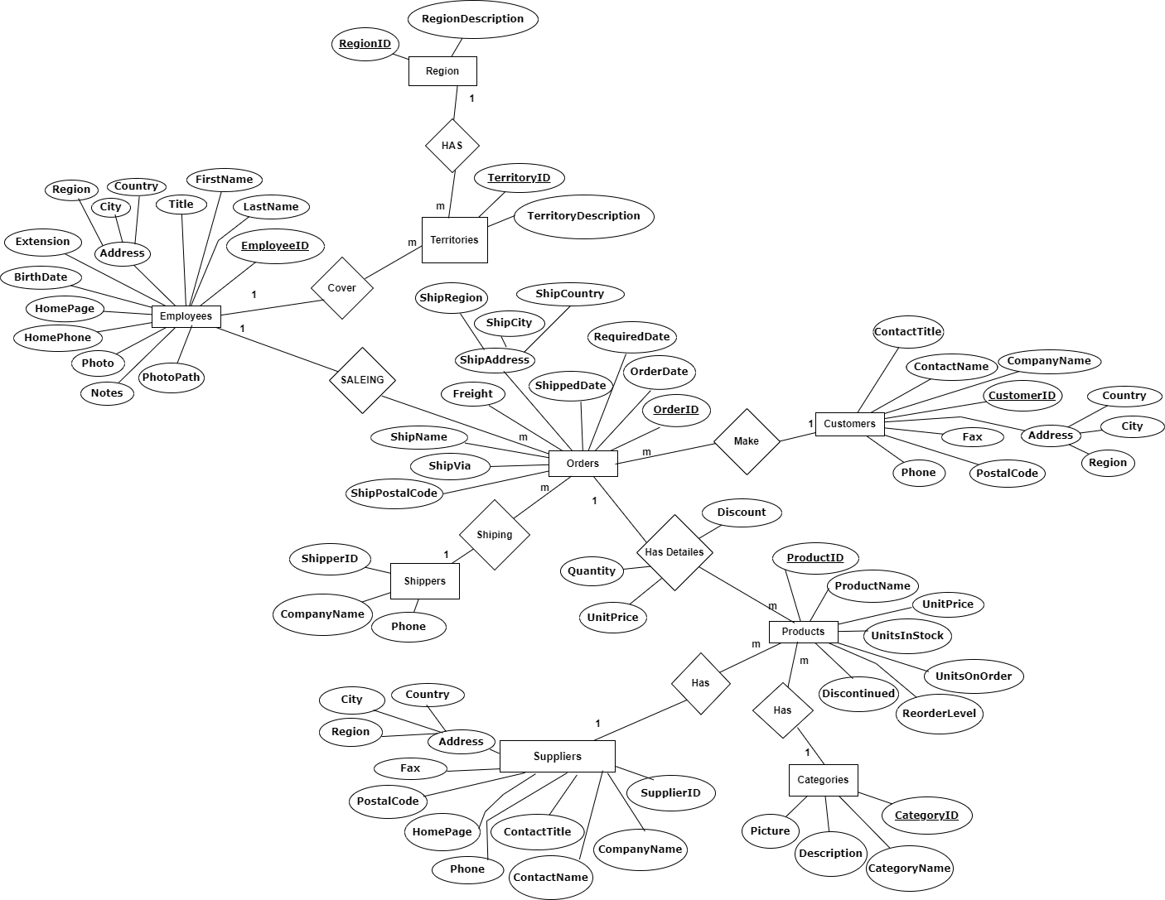
North Wind ERD

Slide 7
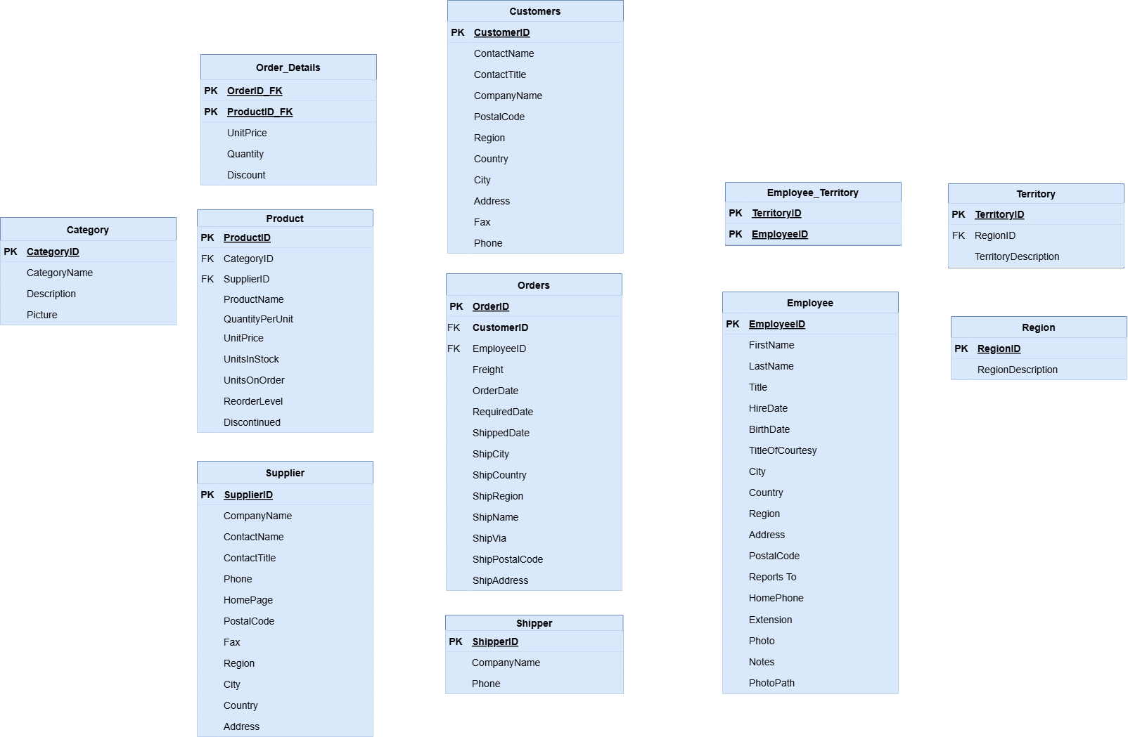
Mapping& Schema

Slide 8
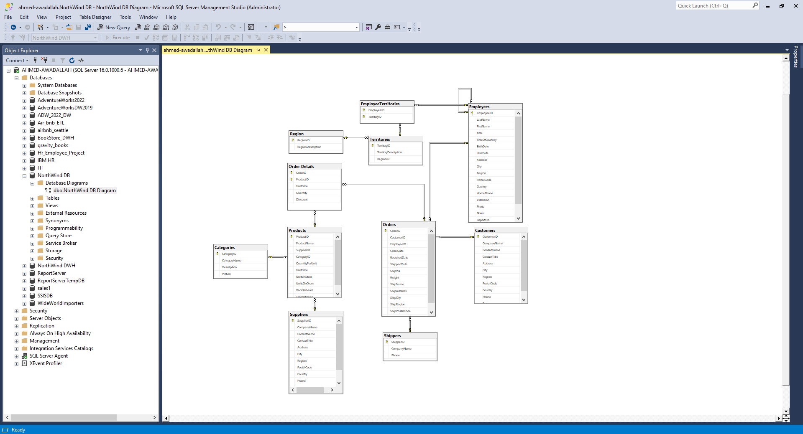
OLTP Database

Slide 9
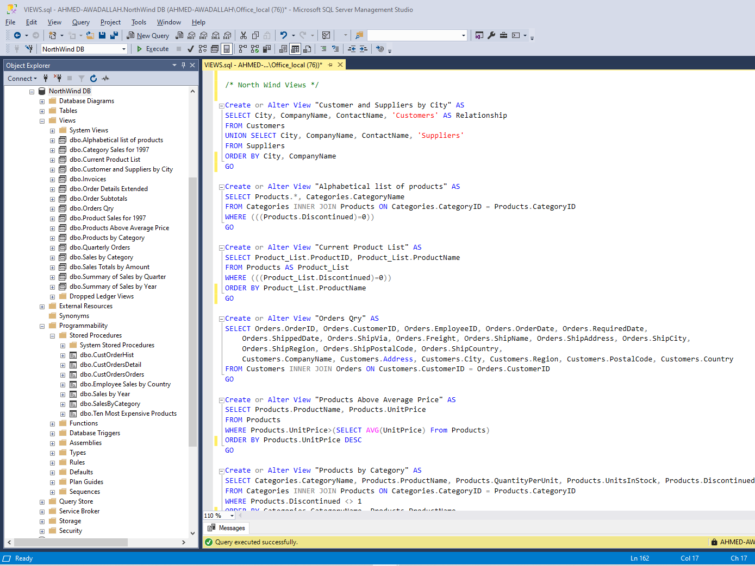
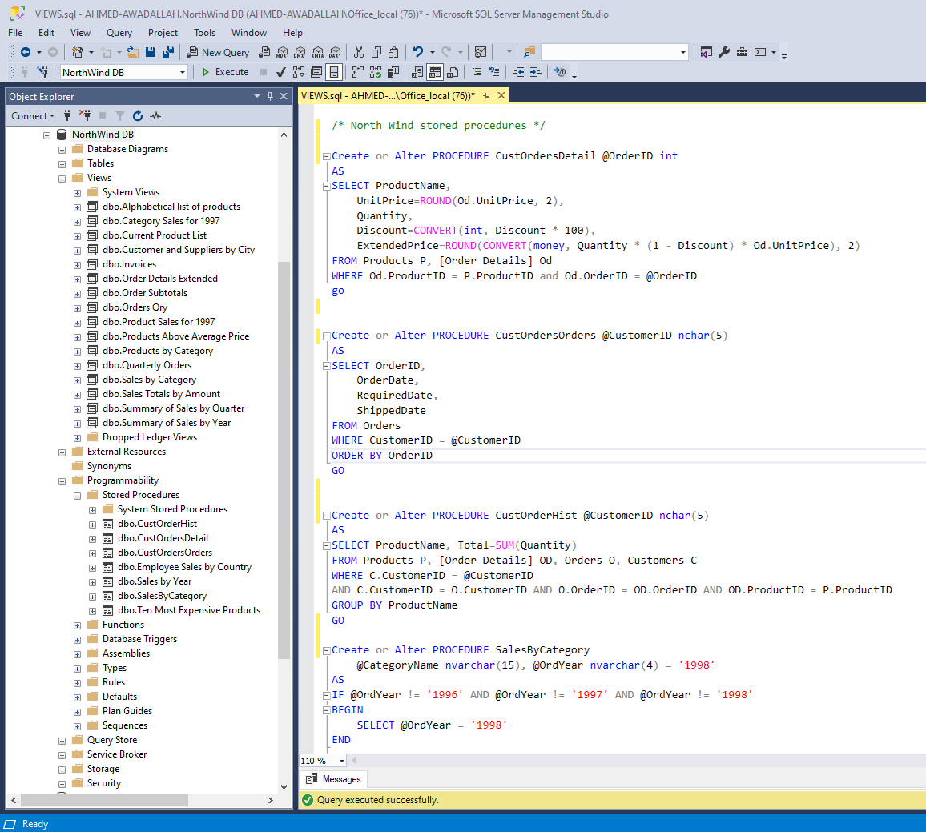
Sql Queries
Create +10 views
+5 Stored Procedure

Slide 10
Stored procedures
ALTER procedure [dbo].[Sales by Year]
@Beginning_Date DateTime, @Ending_Date DateTime AS
SELECT Orders.ShippedDate, Orders.OrderID, "Order Subtotals".Subtotal, DATENAME(yy,ShippedDate) AS Year
FROM Orders INNER JOIN "Order Subtotals" ON Orders.OrderID = "Order Subtotals".OrderID
WHERE Orders.ShippedDate Between @Beginning_Date And @Ending_Date
The [Sales by Year] procedure retrieves order details, including the shipping date, order ID, and subtotal, for orders shipped between a specified start and end date. It also extracts the year from the shipping date, making it useful for generating yearly sales reports.

Slide 11
Stored procedures Cont.
ALTER procedure [dbo].[Employee Sales by Country]
@Beginning_Date DateTime, @Ending_Date DateTime AS
SELECT Employees.Country, Employees.LastName, Employees.FirstName, Orders.ShippedDate, Orders.OrderID, "Order Subtotals".Subtotal AS SaleAmount
FROM Employees INNER JOIN
(Orders INNER JOIN "Order Subtotals" ON Orders.OrderID = "Order Subtotals".OrderID)
ON Employees.EmployeeID = Orders.EmployeeID
WHERE Orders.ShippedDate Between @Beginning_Date And @Ending_Date
The `[Employee Sales by Country]` procedure retrieves sales data, showing each employee's country, name, the shipping date, order ID, and the corresponding sale amount (subtotal) for orders shipped between a specified start and end date. It joins the `Employees`, `Orders`, and `"Order Subtotals"` tables, providing insights into employee performance across different countries.

Slide 12
Stored procedures Cont.
ALTER PROCEDURE [dbo].[SalesByCategory]
@CategoryName nvarchar(15), @OrdYear nvarchar(4) = '1998'
AS
IF @OrdYear != '1996' AND @OrdYear != '1997' AND @OrdYear != '1998'
BEGIN
SELECT @OrdYear = '1998'
END
SELECT ProductName,
TotalPurchase=ROUND(SUM(CONVERT(decimal(14,2), OD.Quantity * (1-OD.Discount) * OD.UnitPrice)), 0)
FROM [Order Details] OD, Orders O, Products P, Categories C
WHERE OD.OrderID = O.OrderID
AND OD.ProductID = P.ProductID
AND P.CategoryID = C.CategoryID
AND C.CategoryName = @CategoryName
AND SUBSTRING(CONVERT(nvarchar(22), O.OrderDate, 111), 1, 4) = @OrdYear
GROUP BY ProductName
ORDER BY ProductName
The `[SalesByCategory]` procedure retrieves the total purchase amount for each product in a specified category and year, defaulting to 1998 if the provided year is not 1996, 1997, or 1998. It joins the `Order Details`, `Orders`, `Products`, and `Categories` tables, calculating total sales by multiplying the quantity, discount, and unit price, and groups the results by product name for the selected category and year.

Slide 13
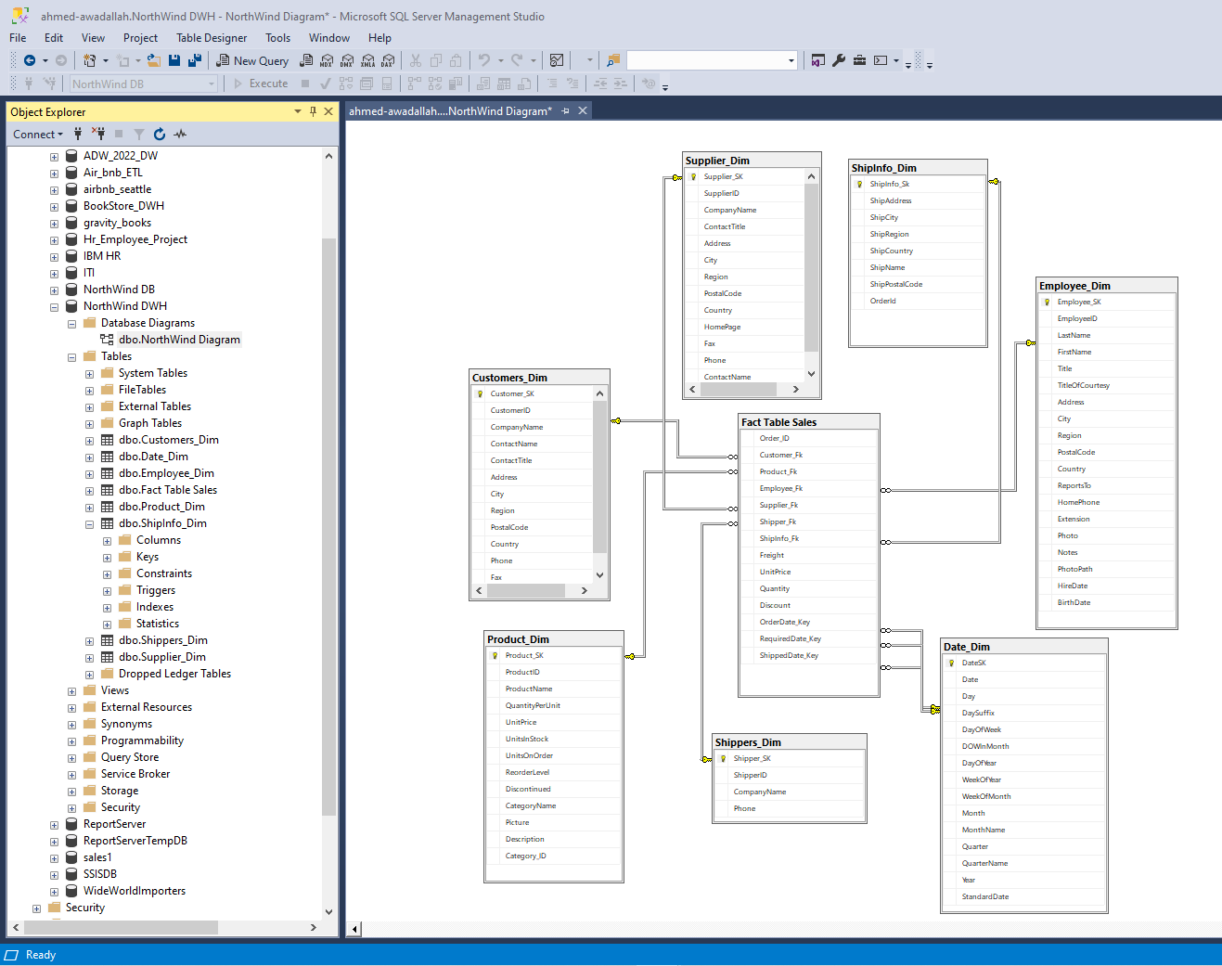
DWH Mapping
Star Schema
faster query execution
straightforward structure
6 Dimensions
Role Playing Dimension

Slide 14

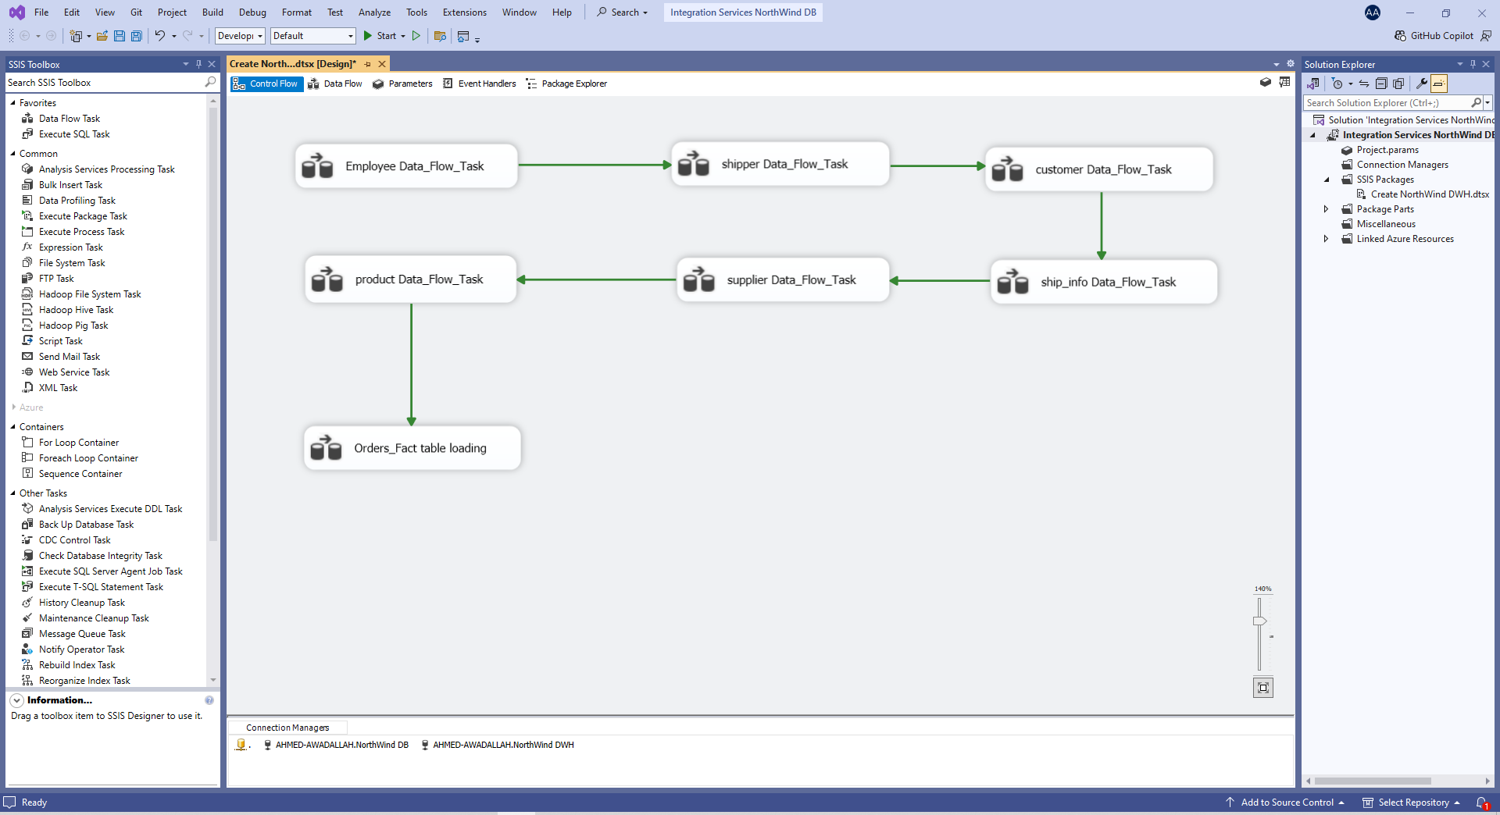
ETL | SSIS

Slide 15
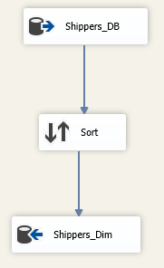
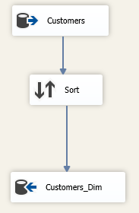
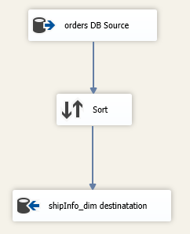
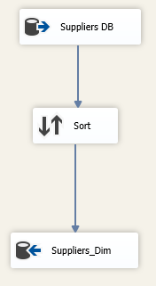
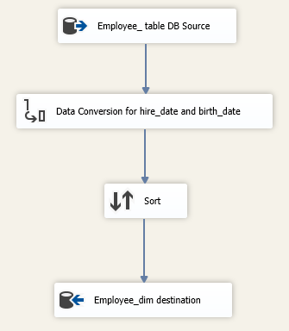
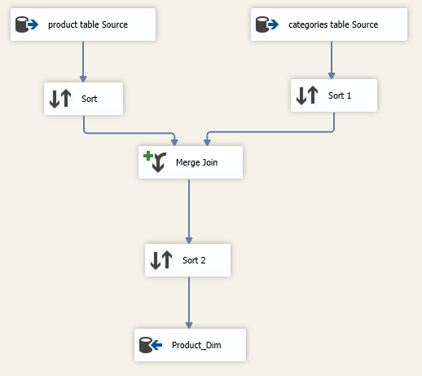
ETL | SSIS

Slide 16
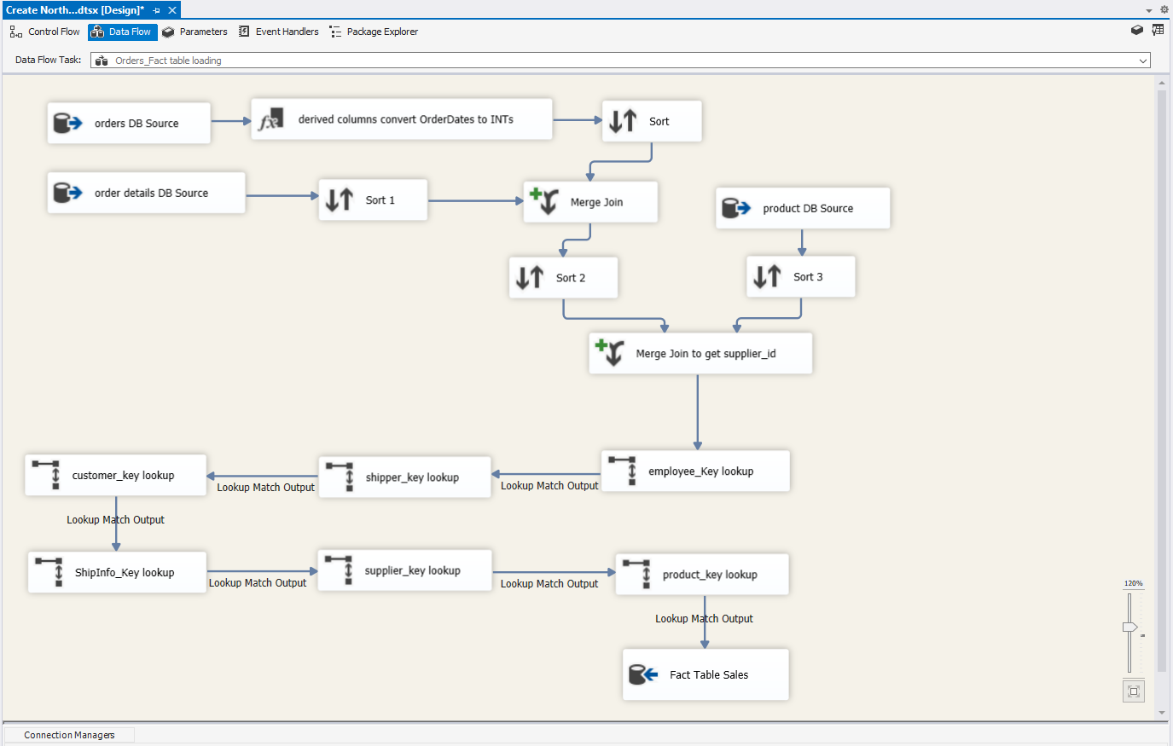
ETL | SSIS

Slide 17

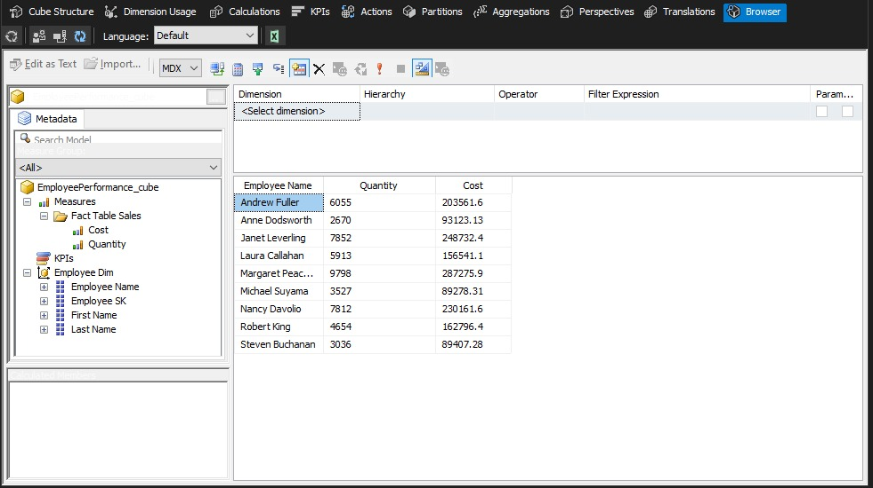
Analysis | SSAS

Slide 18
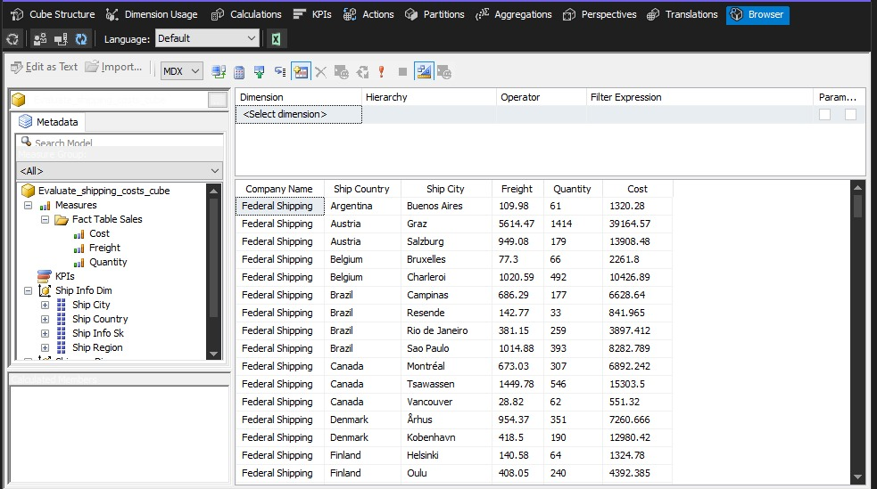
Analysis | SSAS

Slide 19
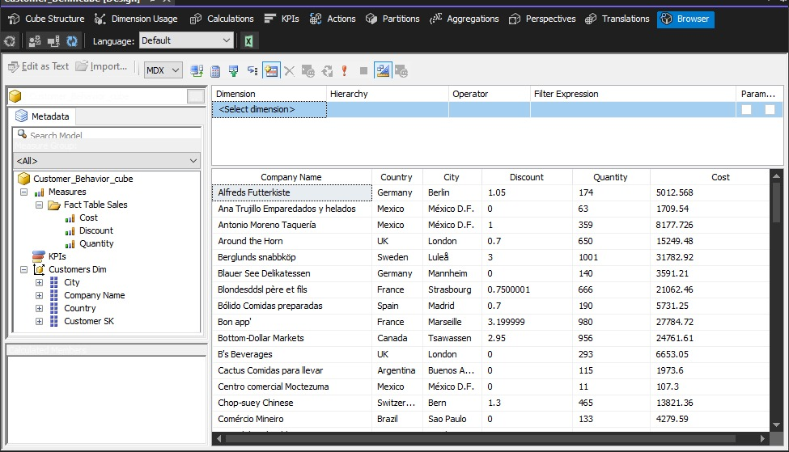
Analysis | SSAS

Slide 20
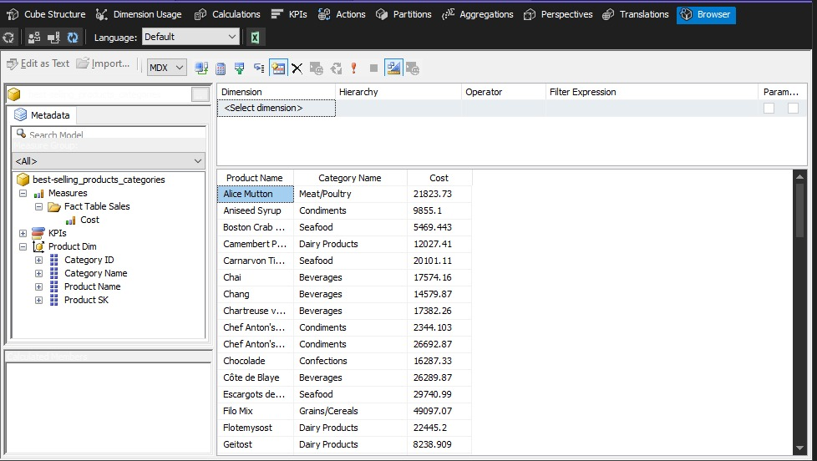
Analysis | SSAS

Slide 21
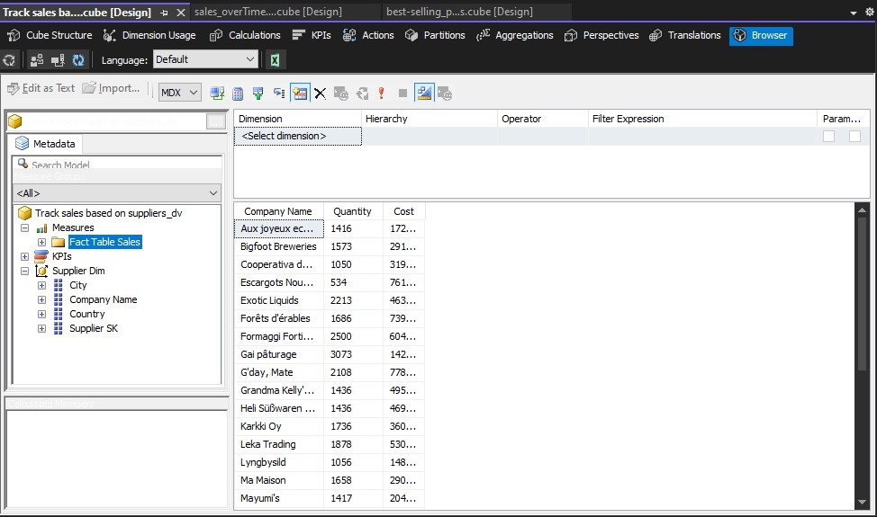
Analysis | SSAS

Slide 22
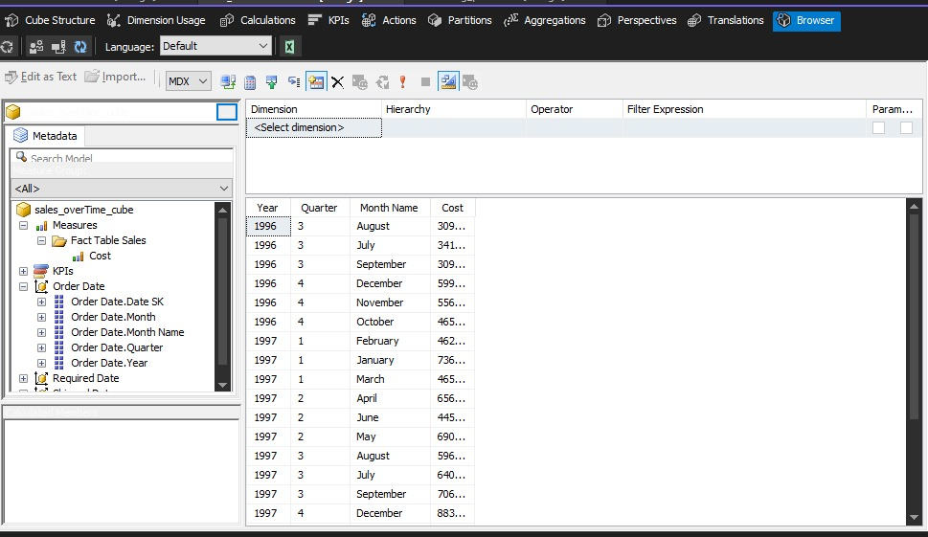
Analysis | SSAS

Slide 23

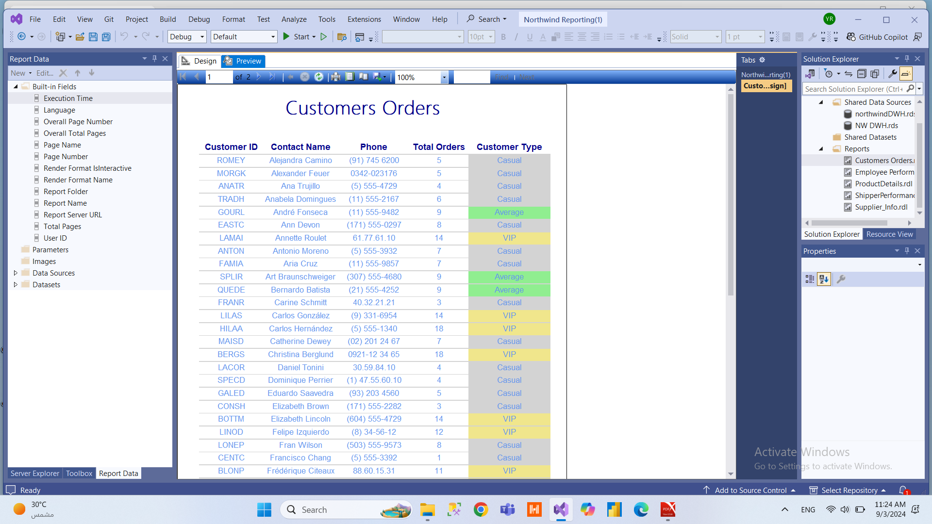
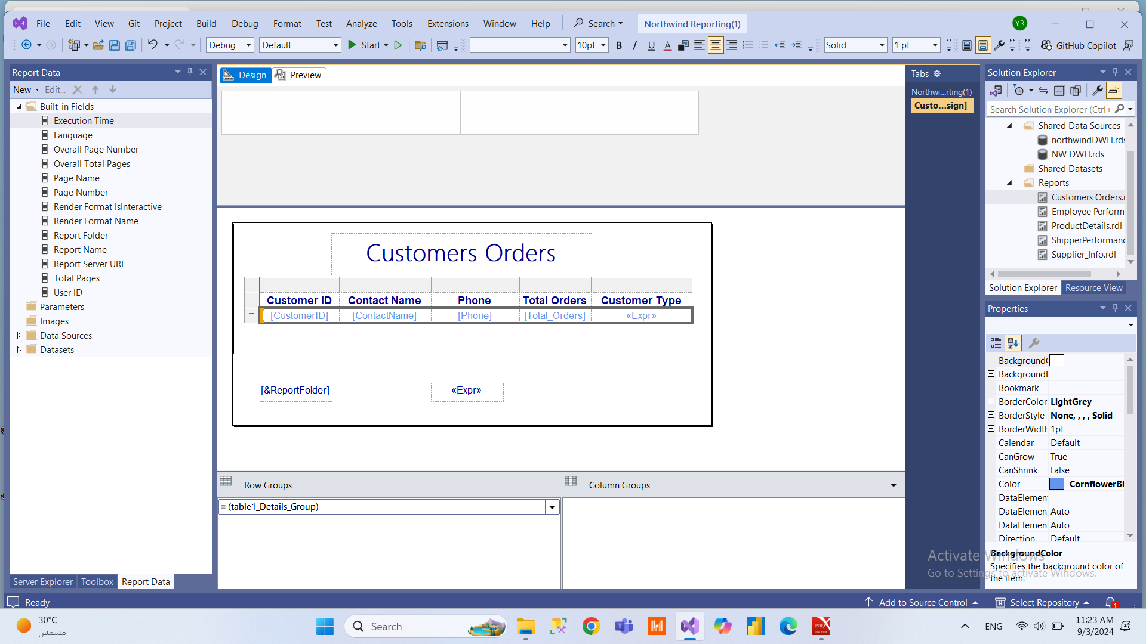
Reporting | SSRS

Slide 24
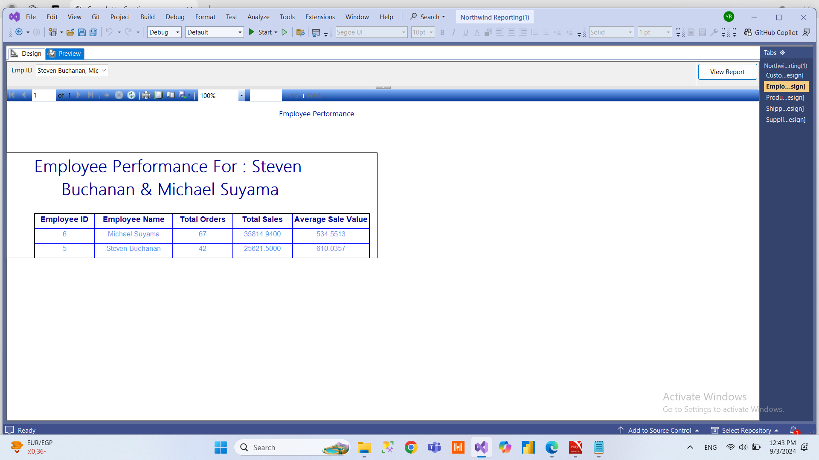
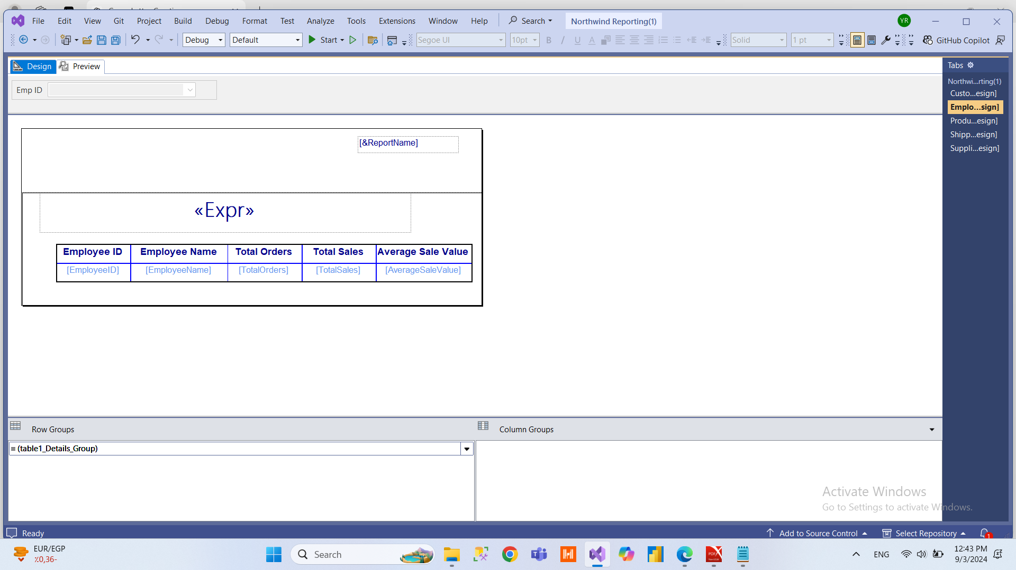
Reporting | SSRS

Slide 25
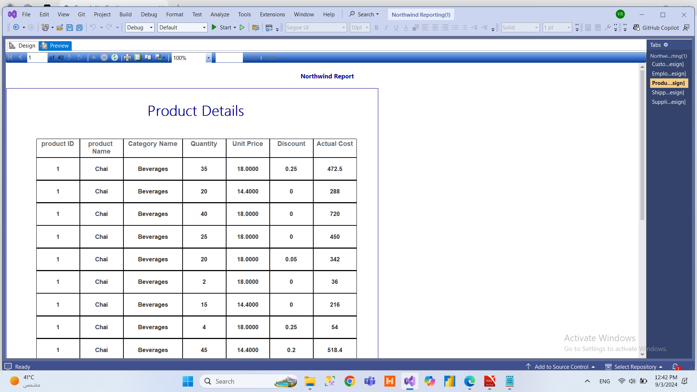
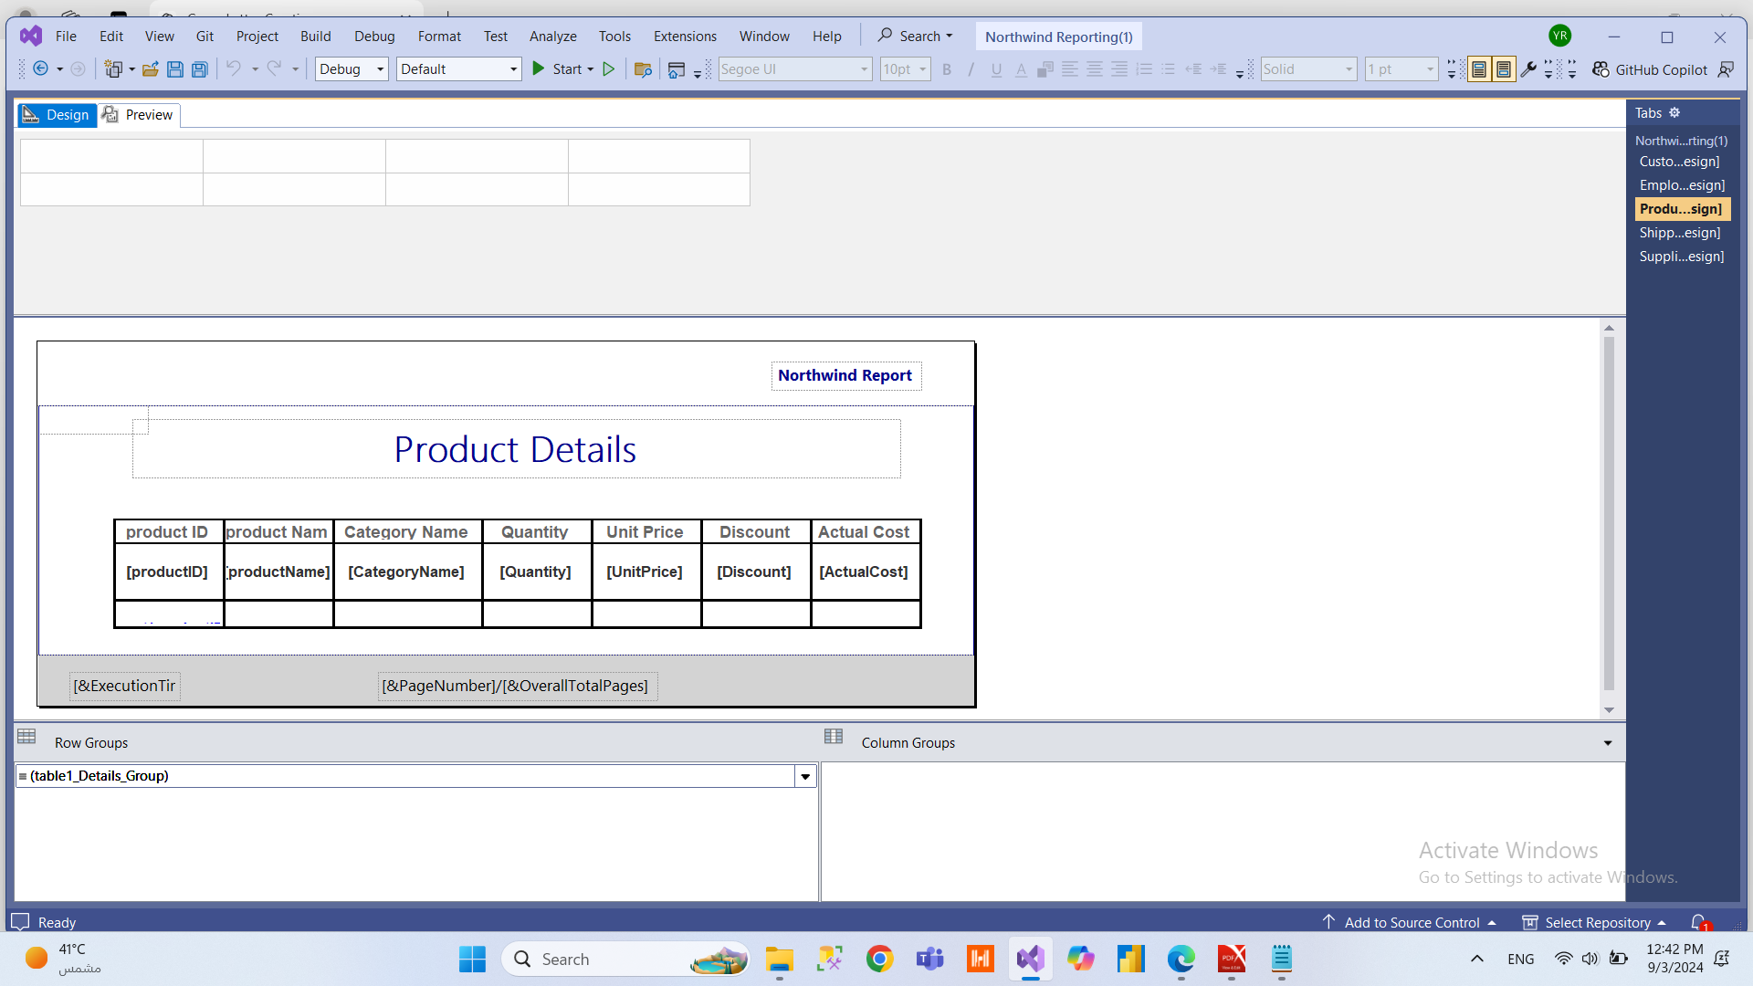
Reporting | SSRS

Slide 26
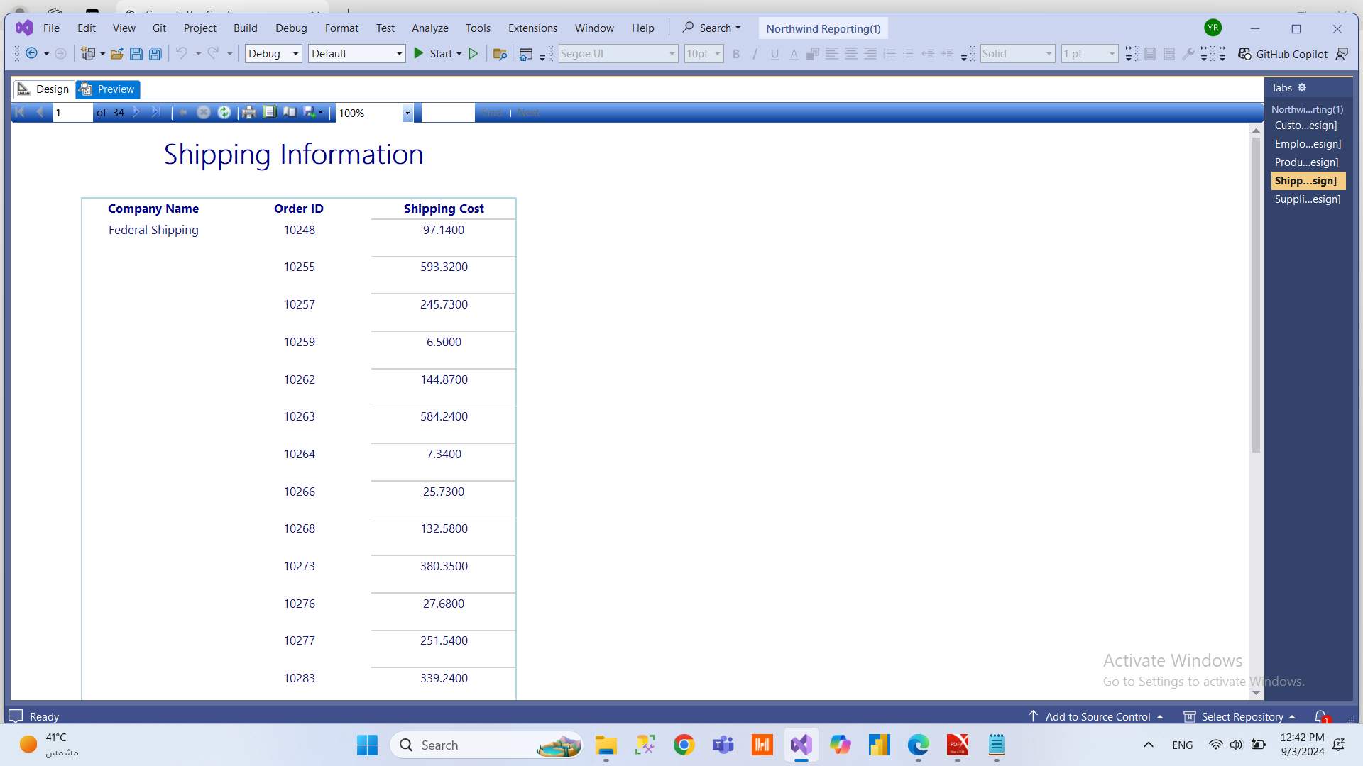
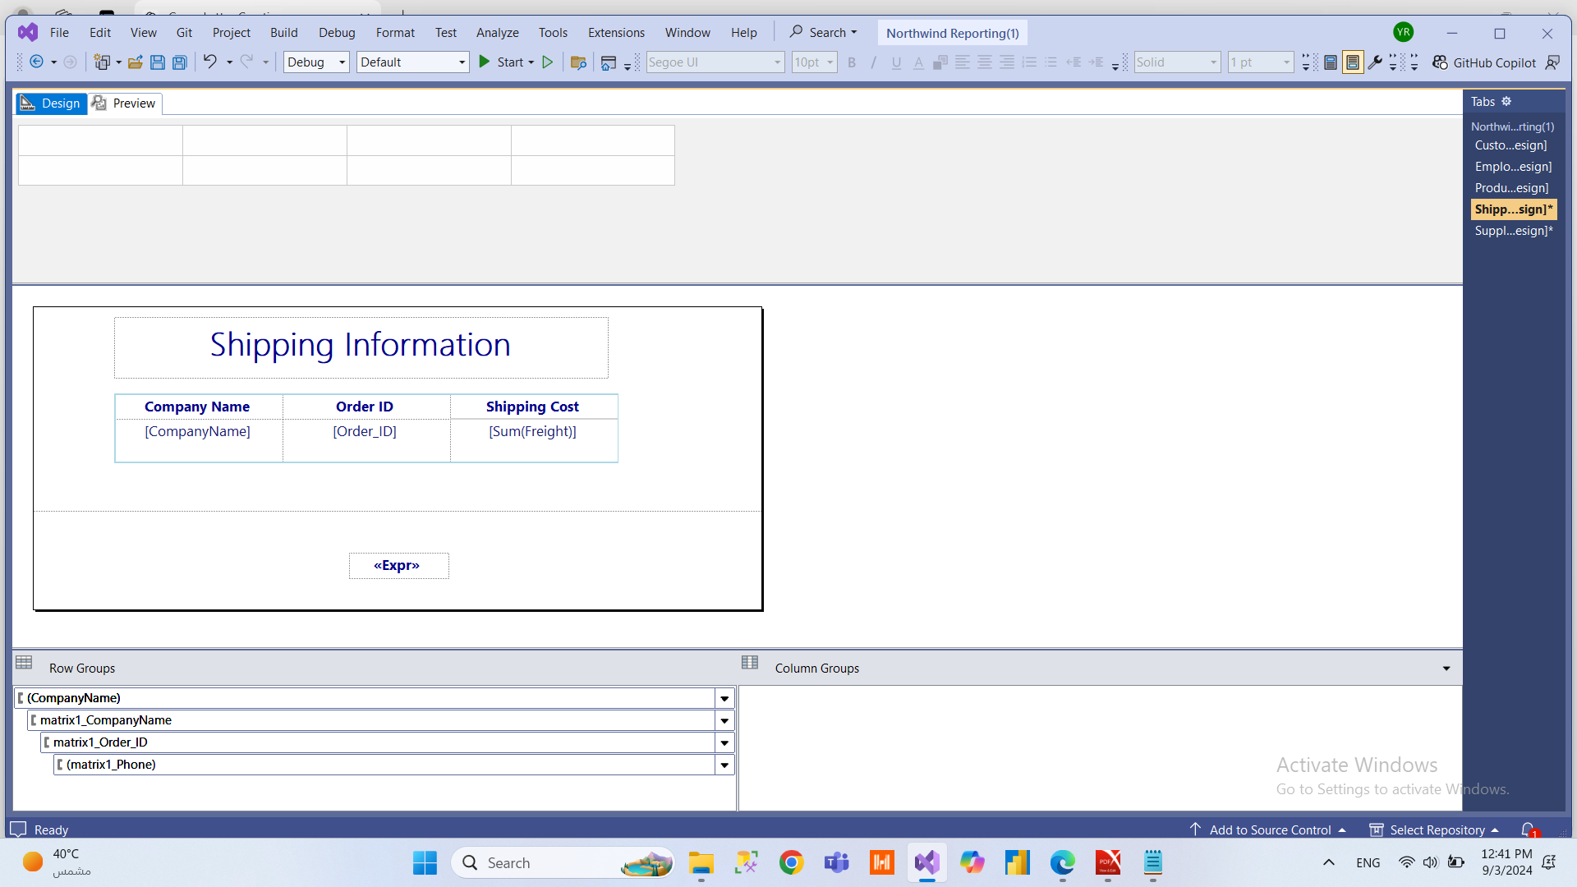
Reporting | SSRS

Slide 27
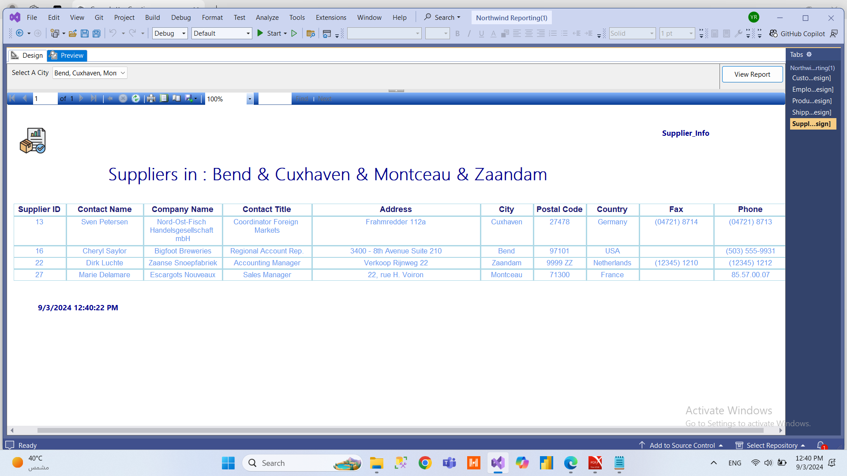
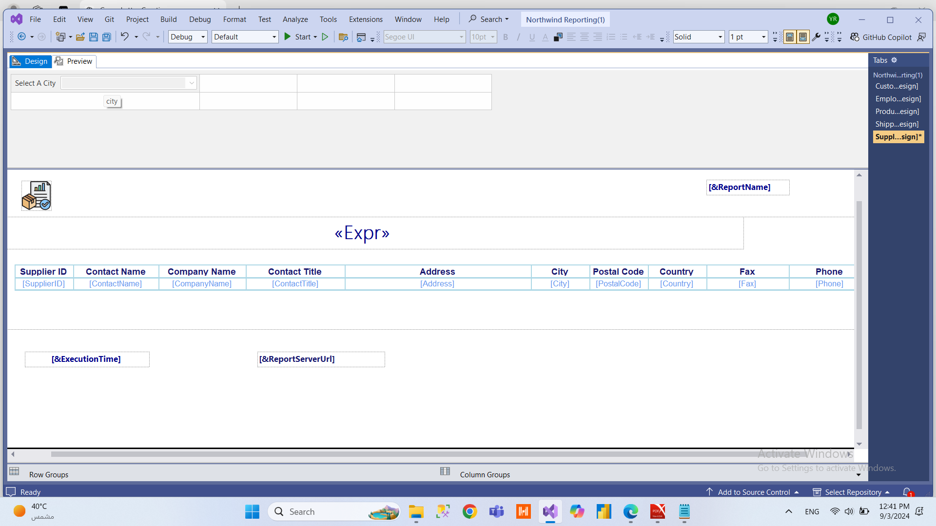
Reporting | SSRS

Slide 28

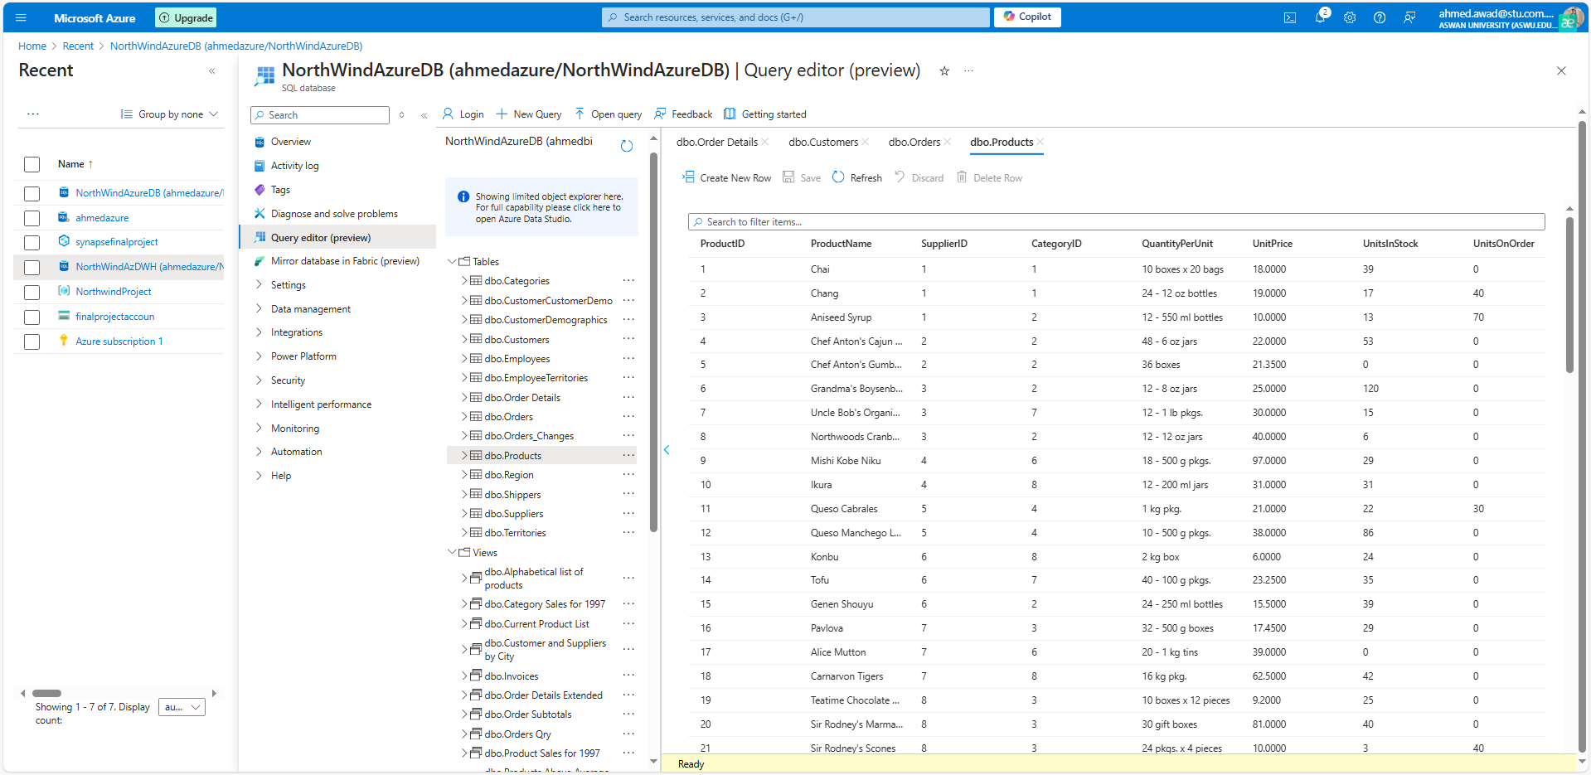
Azure Database
CLOUD

Slide 29
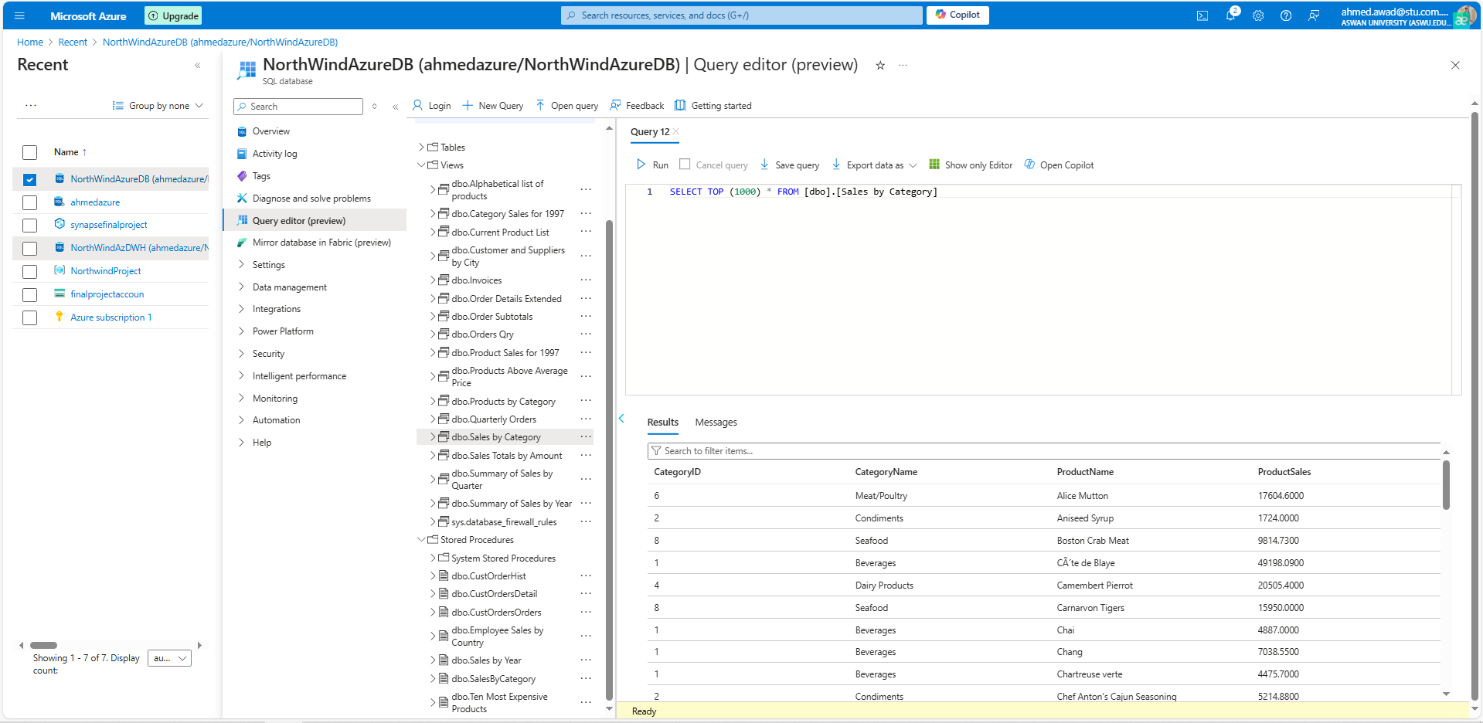
Azure Database
Views | Stored Procedure
CLOUD

Slide 30
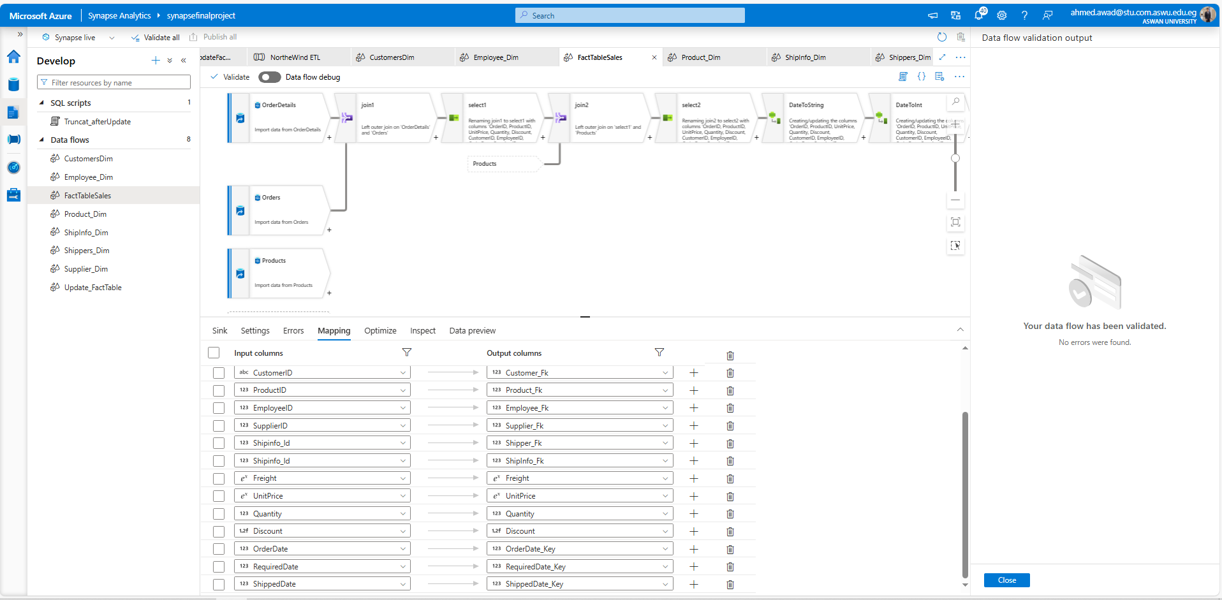
Azure Synabse
Data Flow

Slide 31
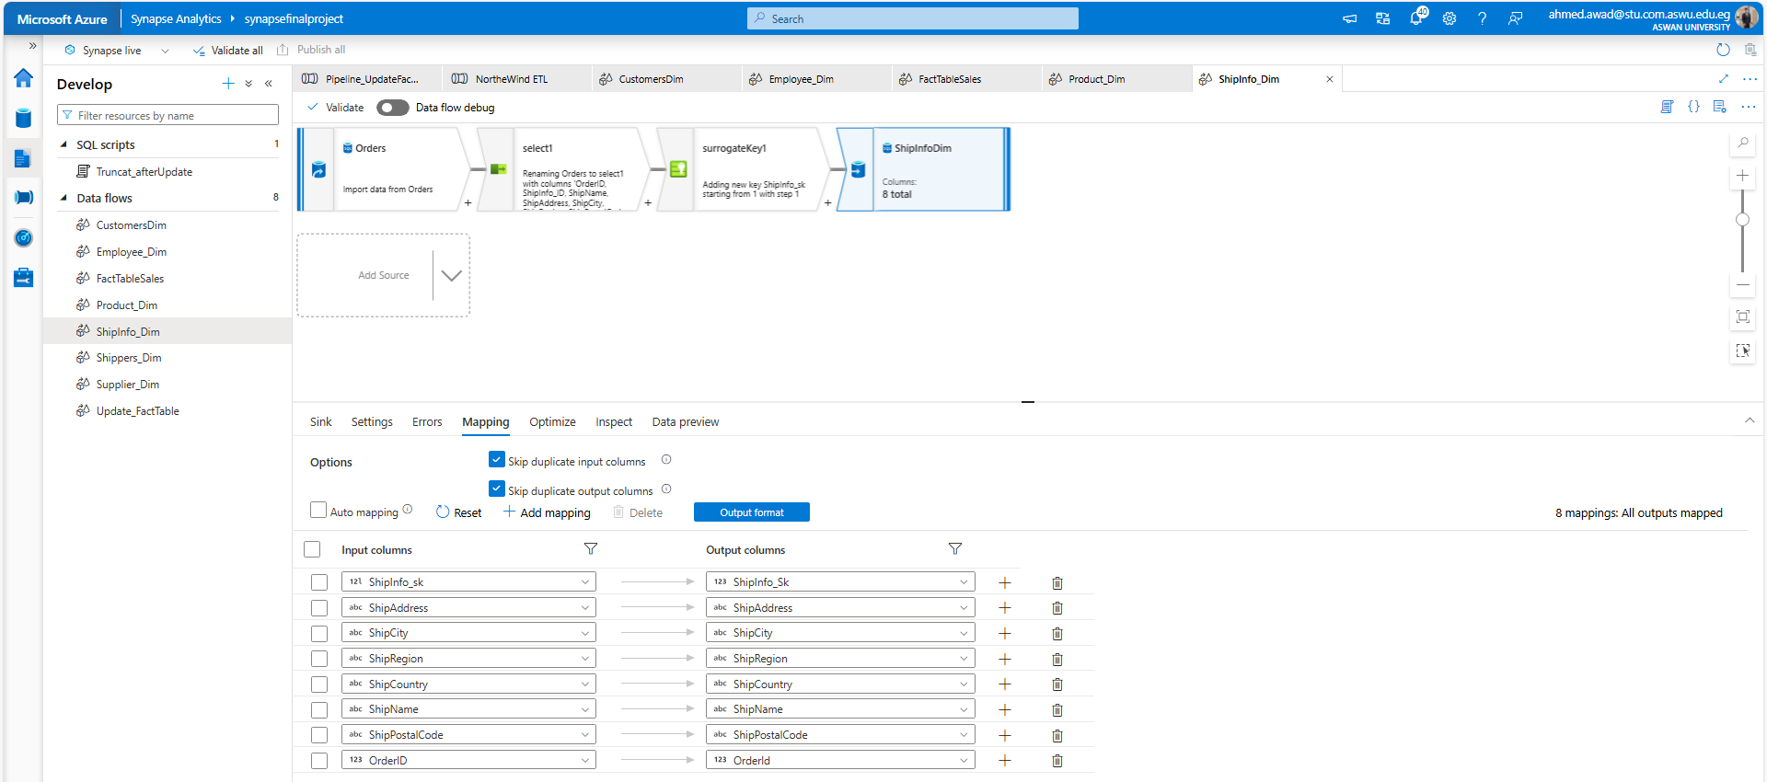
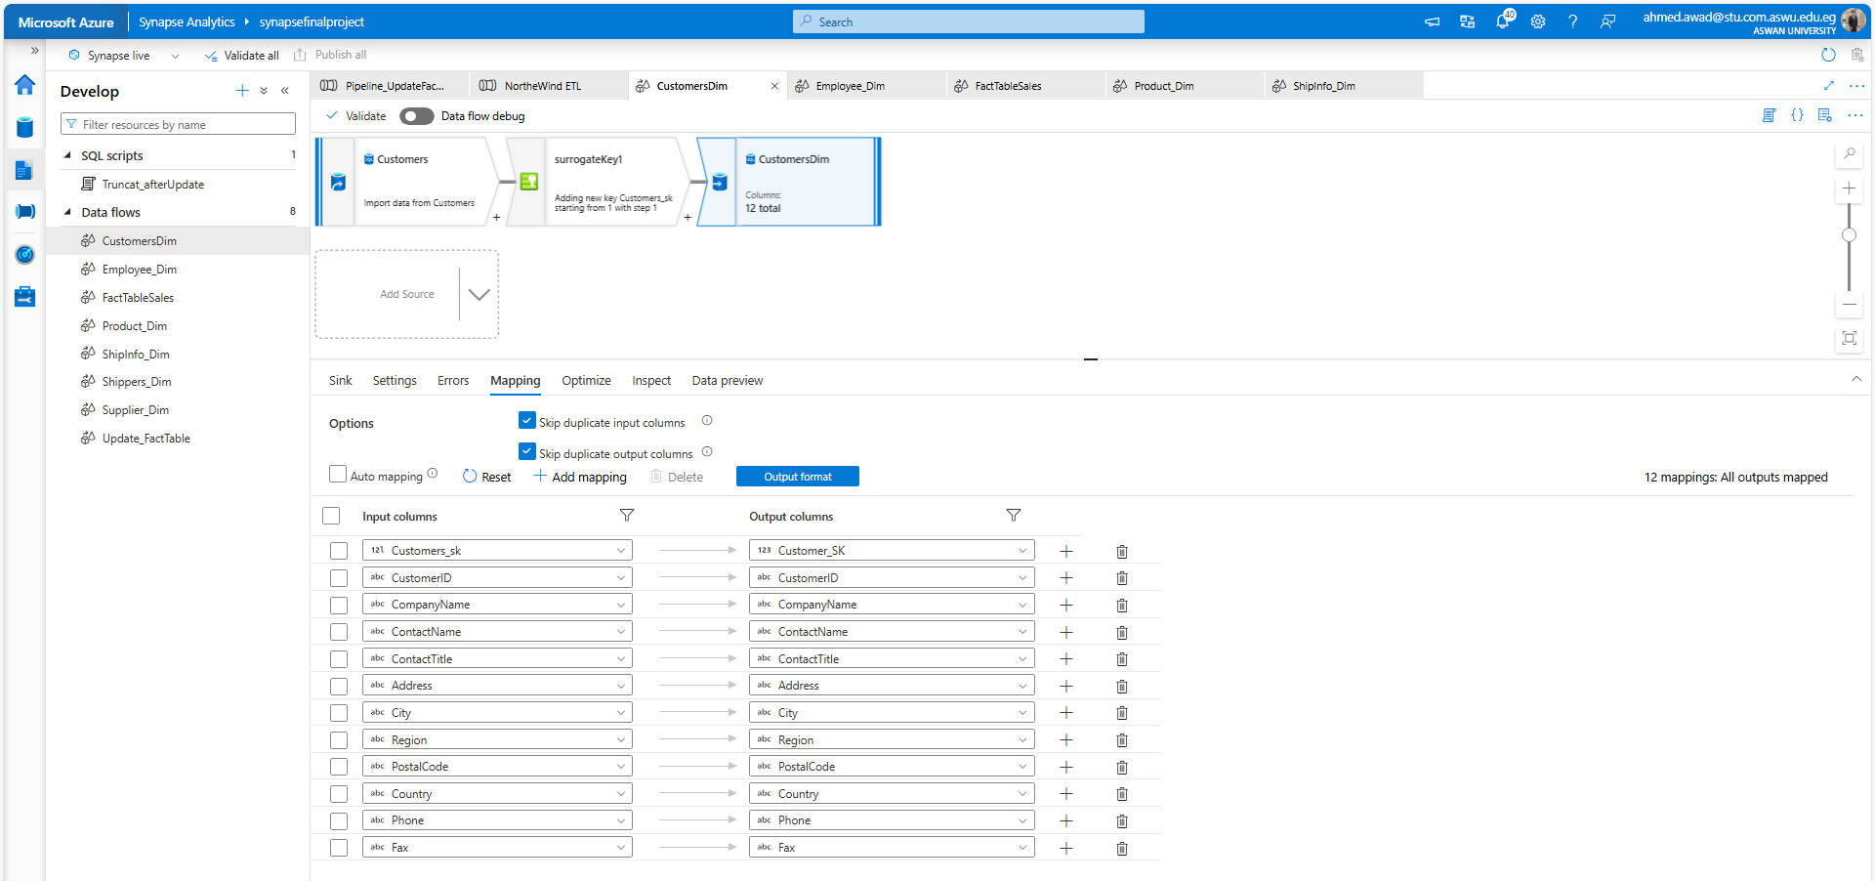
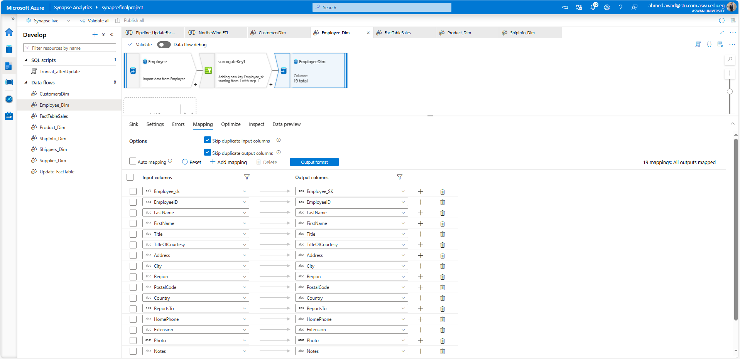
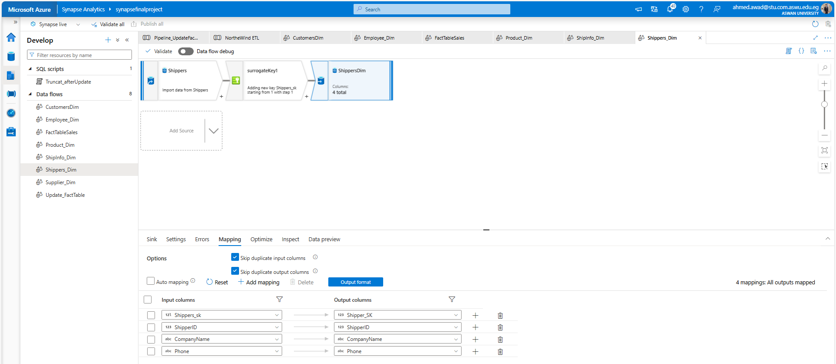
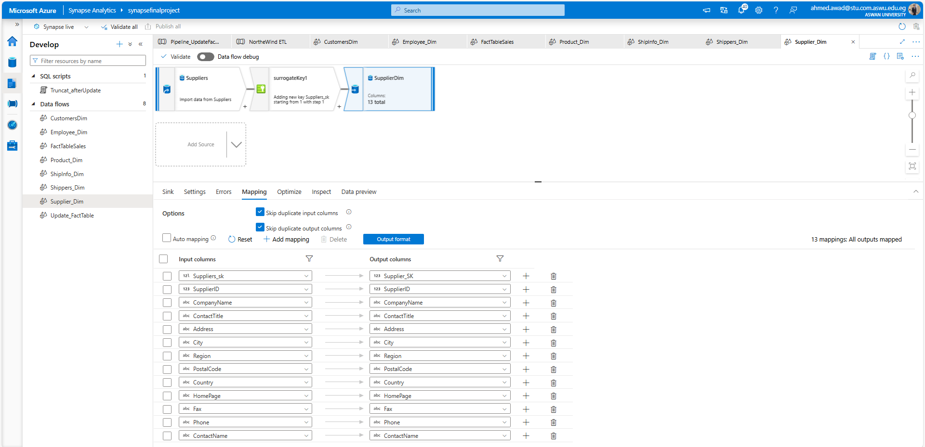
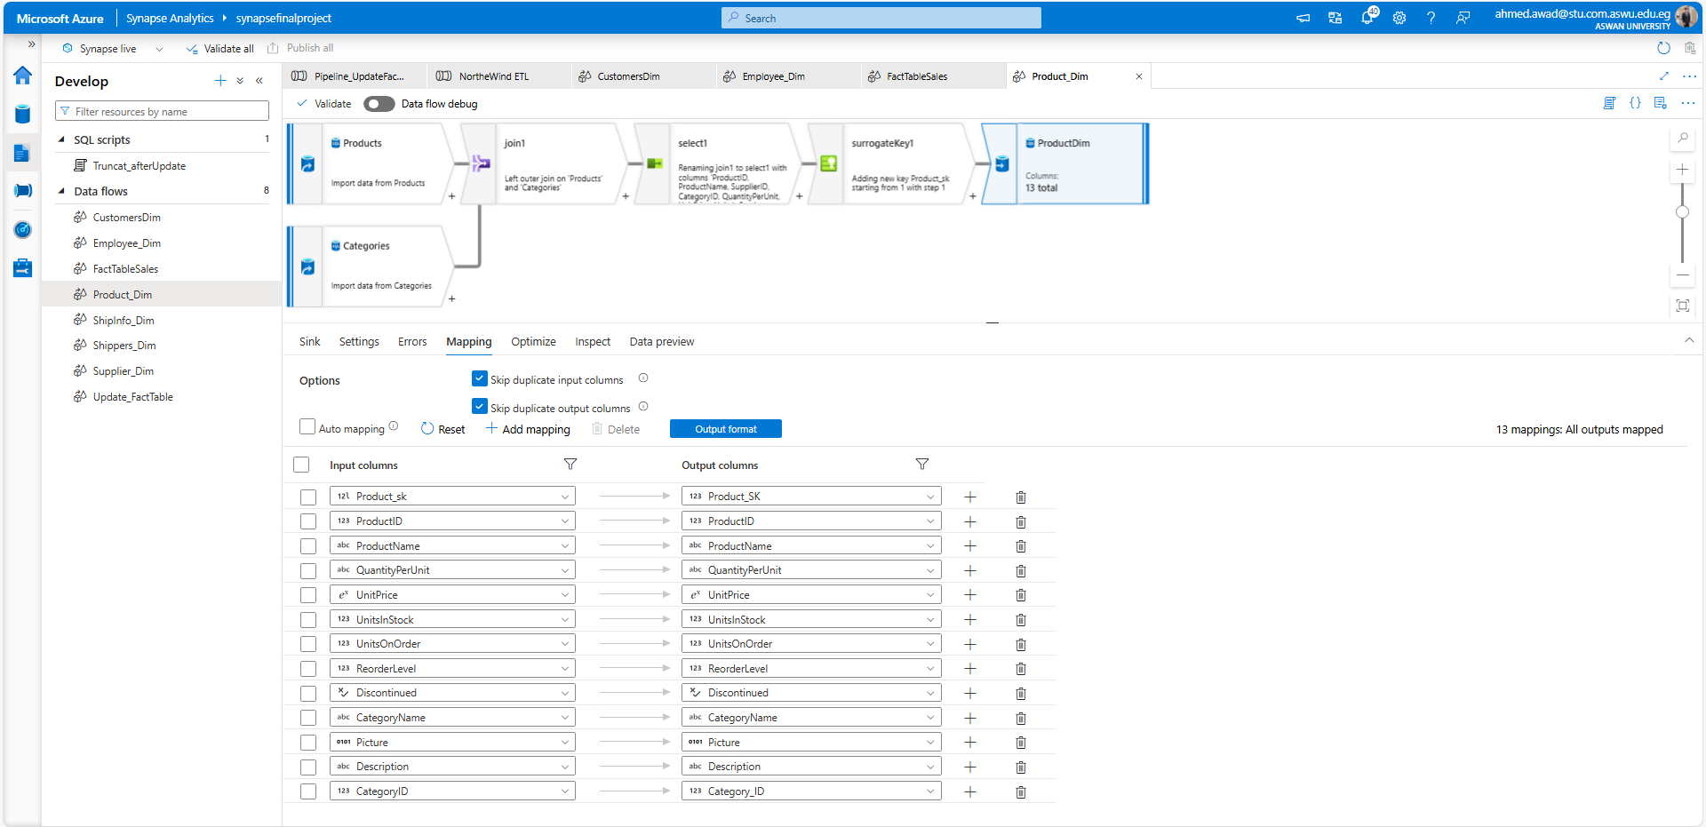
Azure Synabse
Data Flow

Slide 32
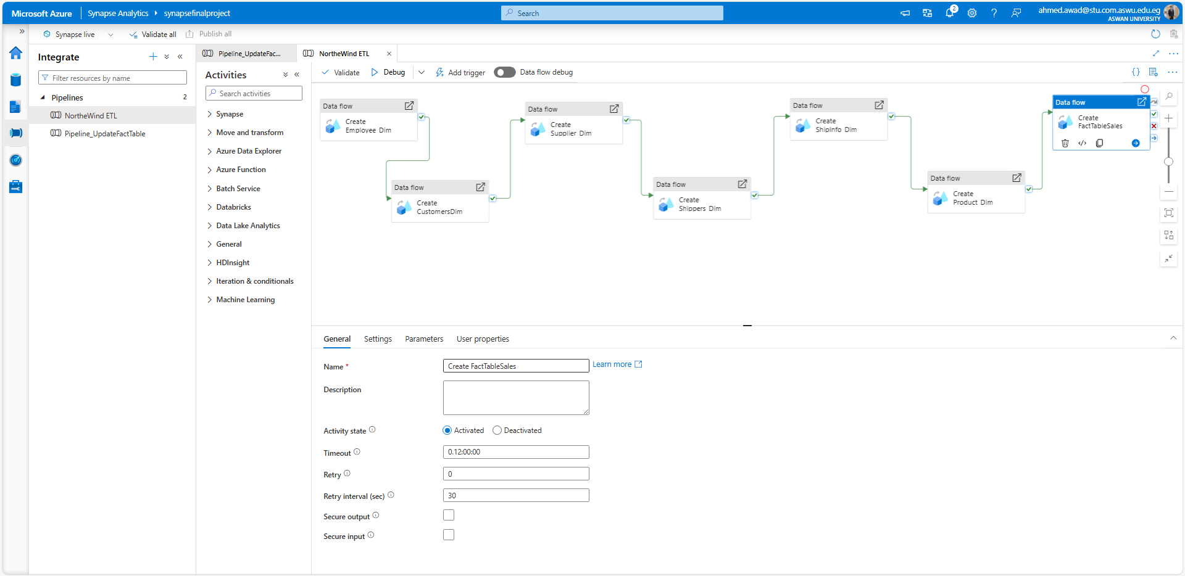
Azure Synabse
Pipeline

Slide 33
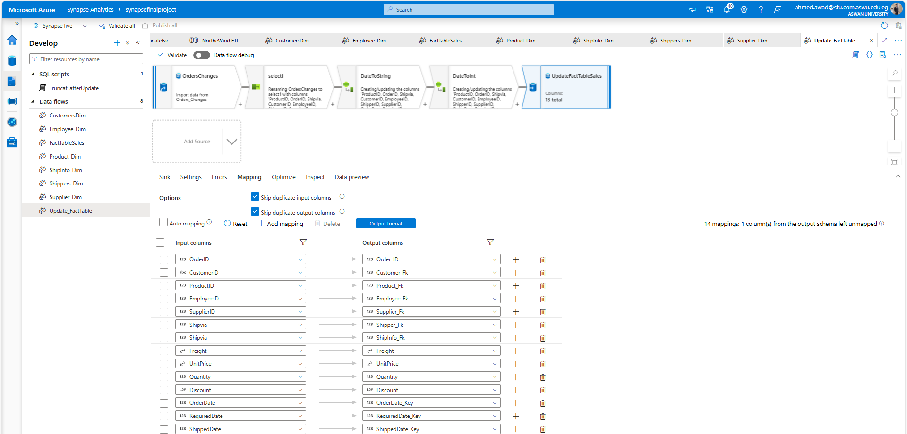
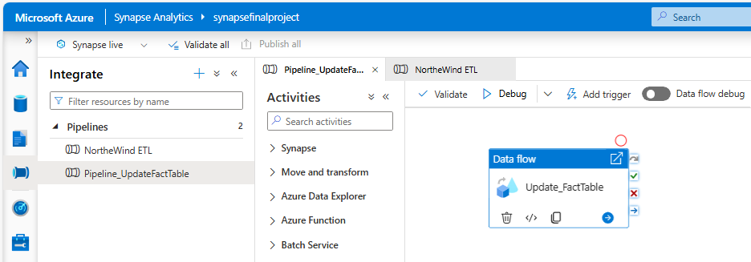
Azure Synabse
Update Fact Table

Slide 34

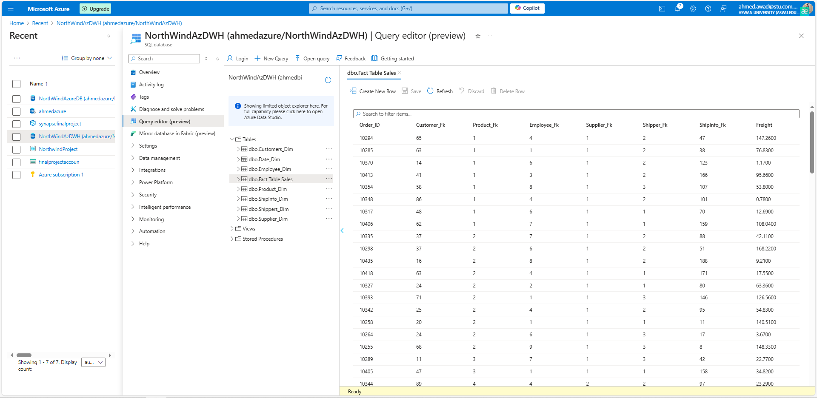
Azure DWH

Slide 35


Power Bi Dashboard

Slide 36
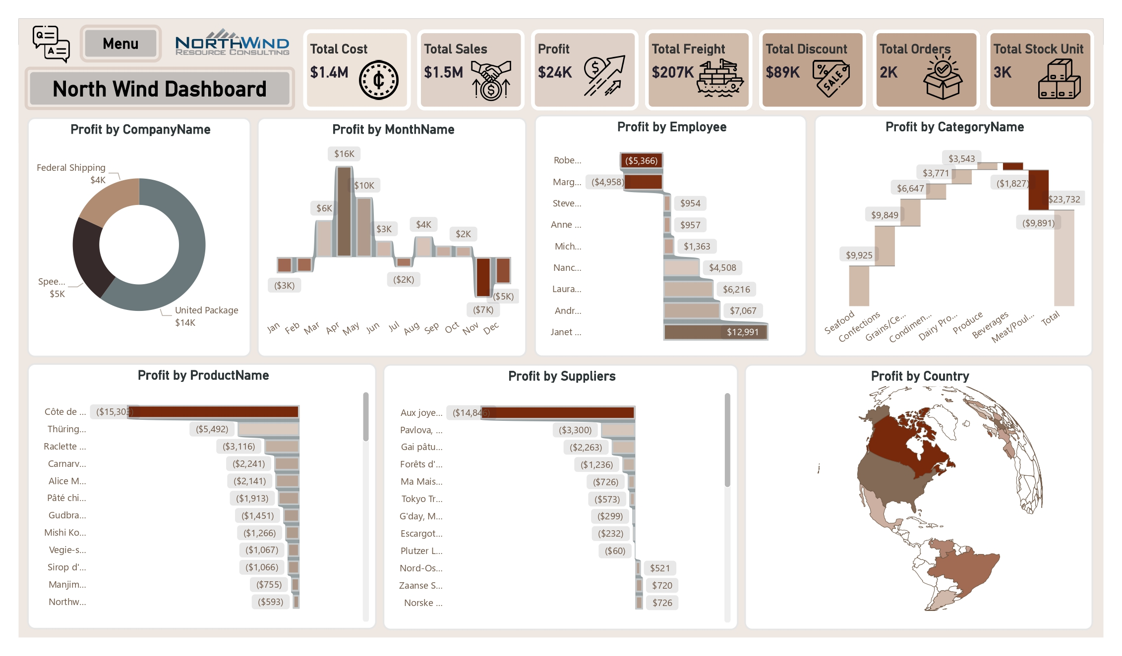
Power Bi Dashboard

Slide 37
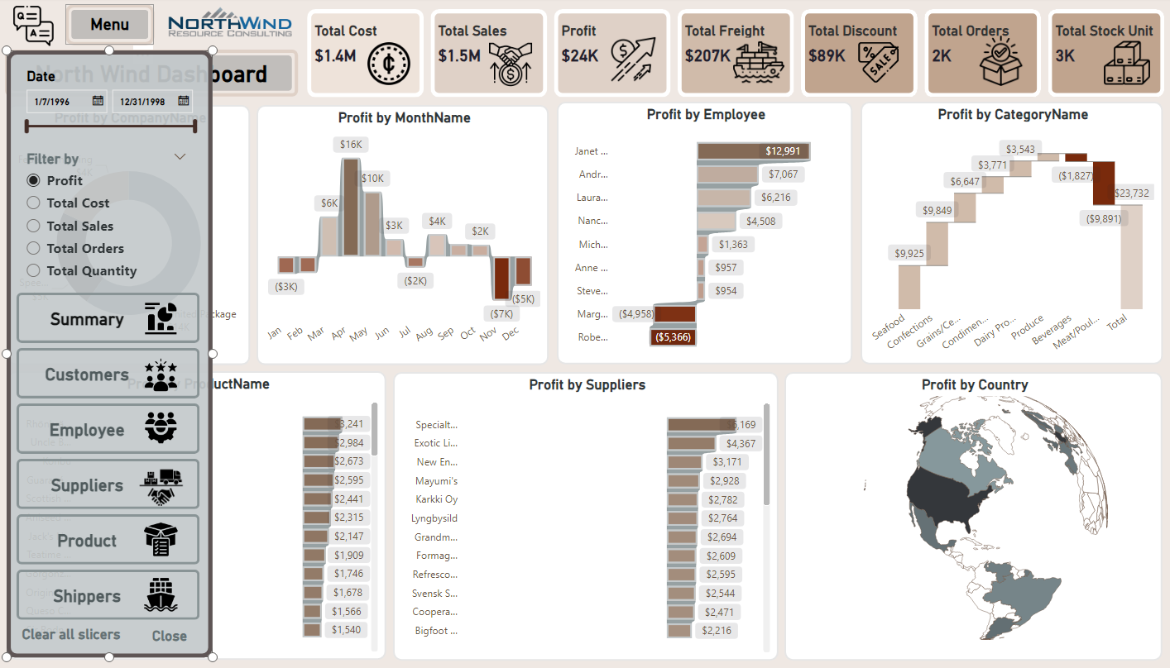
Power Bi Dashboard
Hide Bookmarks
Filters
Navigator

Slide 38
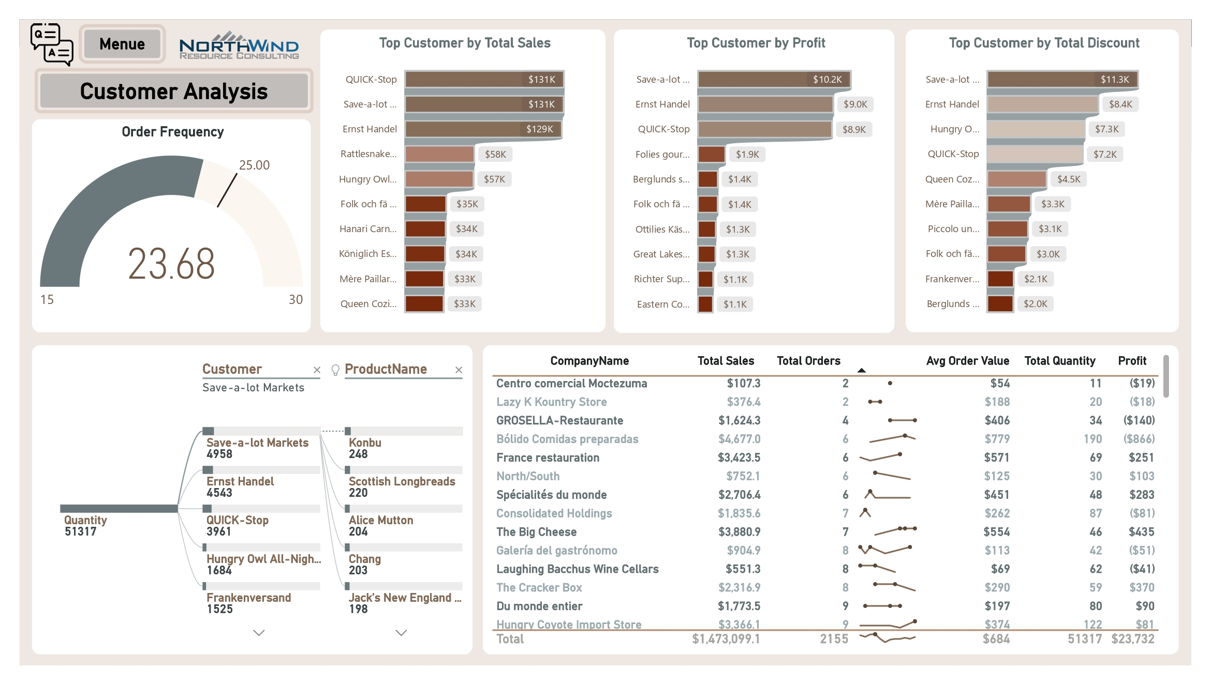
Power Bi Dashboard

Slide 39
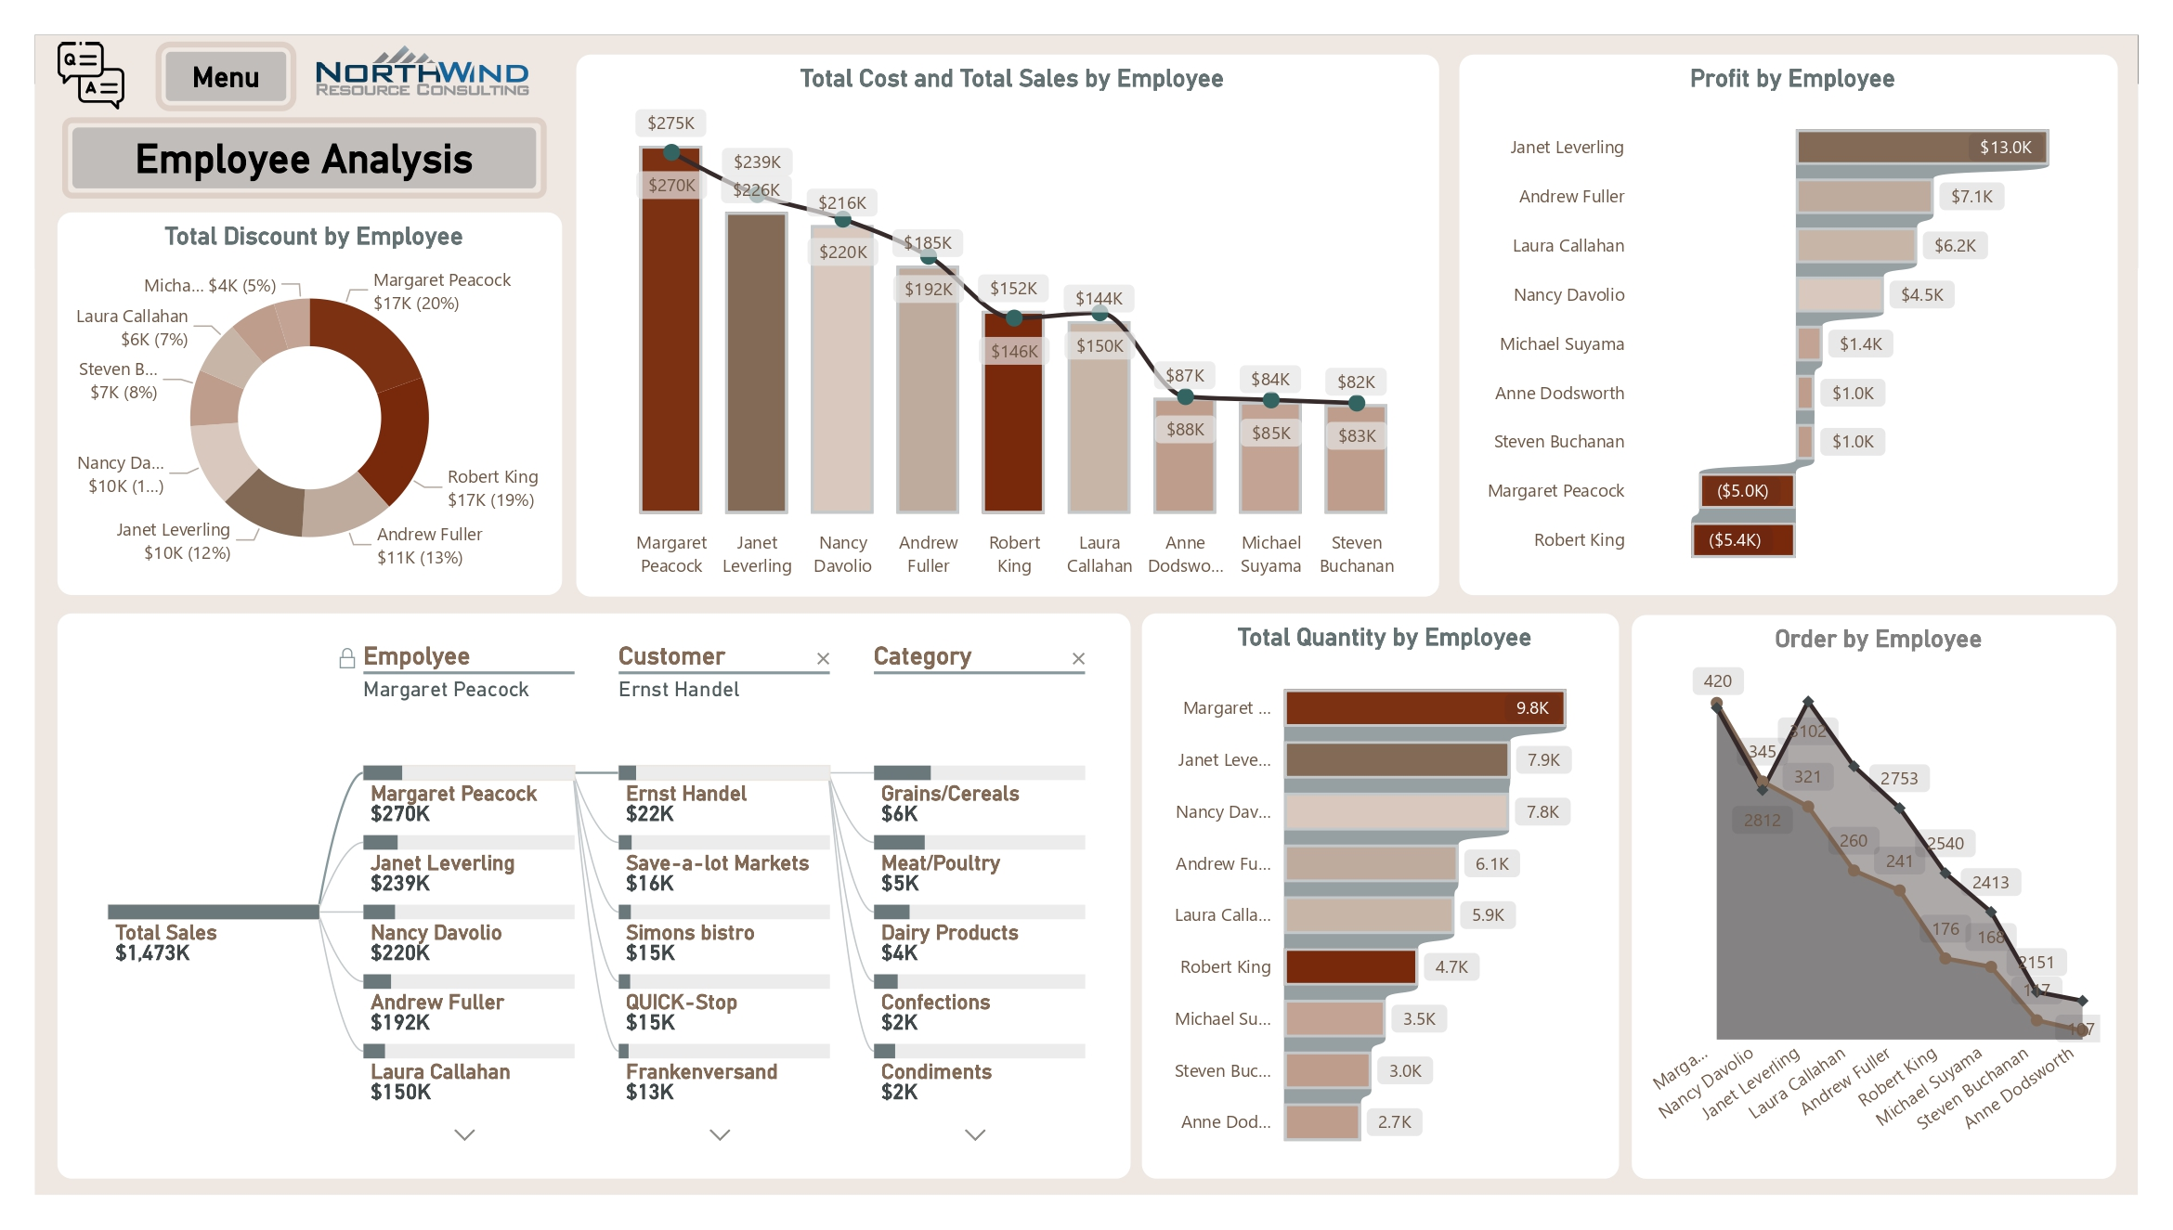
Power Bi Dashboard

Slide 40
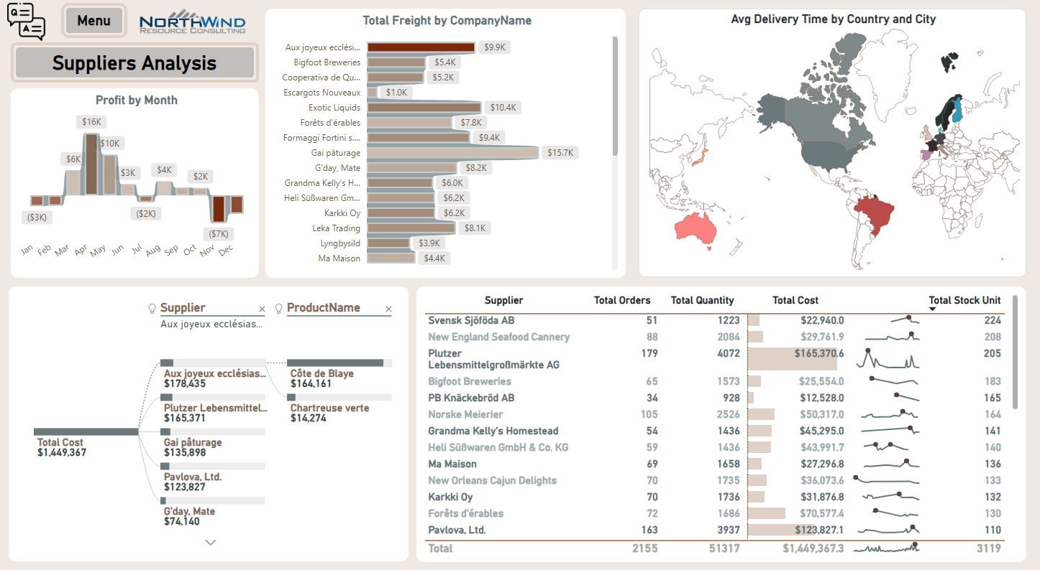
Power Bi Dashboard

Slide 41
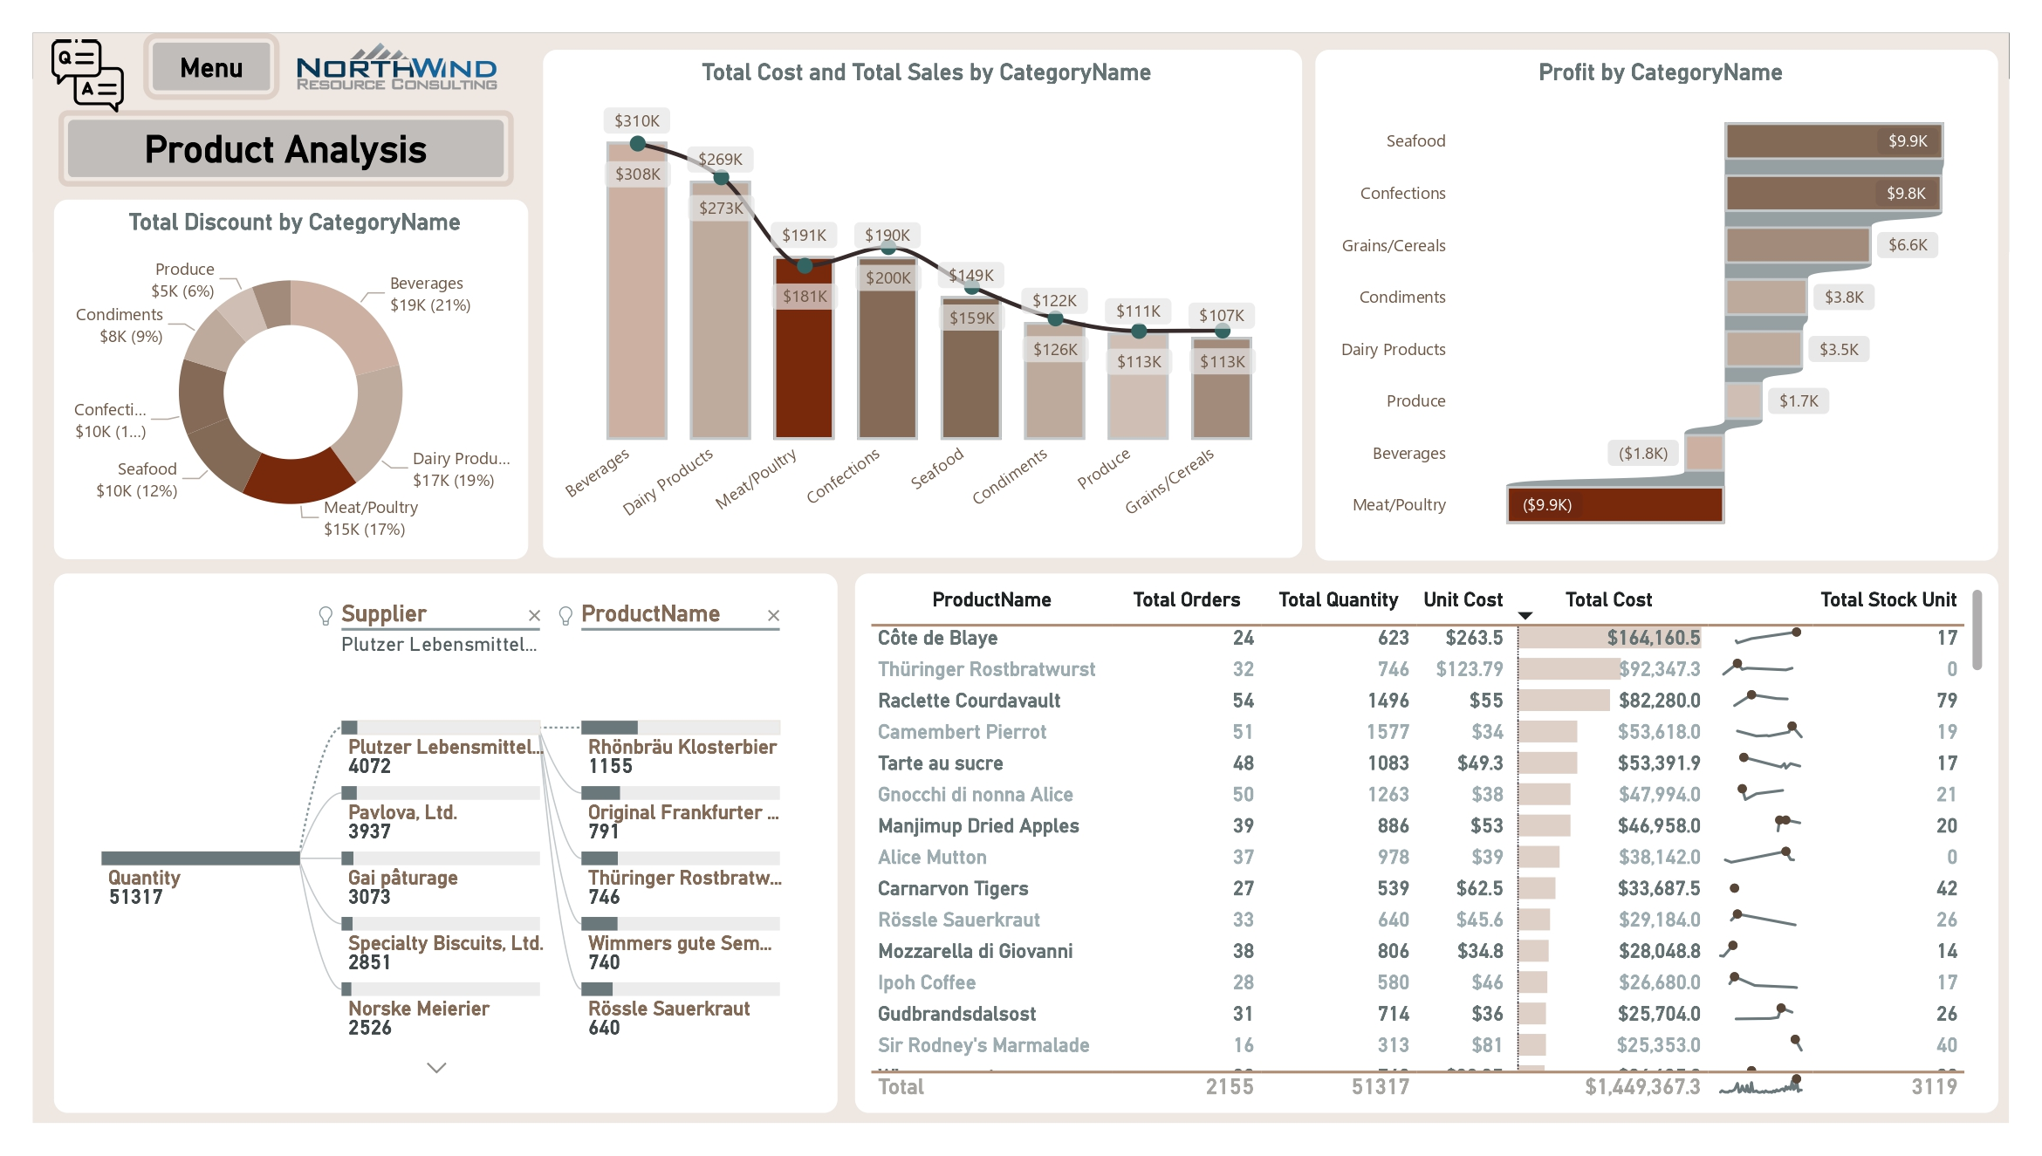
Power Bi Dashboard

Slide 42

Power Bi Dashboard

Slide 43

Power Bi Dashboard
Q&A

Slide 44


Tableau Dashboard

Slide 45

Tableau Dashboard

Slide 46

Tableau Dashboard

Slide 47


Python Dashboard
Pandas
Plotly
Streamlit

Slide 48



Python Dashboard
Pandas
Plotly
Streamlit

Slide 49

Python Dashboard
Web Page

Slide 50

Excel Dashboard

Slide 51


